Slide 1
Regularization for Deep Learning
Lecture slides for Chapter 7 of Deep Learning
www.deeplearningbook.org
Ian Goodfellow
2016-09-27
Adapted by m.n. for CMPS 392

Slide 2
Definition
“Regularization is any modification we make to a learning algorithm that is intended to reduce its generalization error but not its training error.”
Developing more effective regularization strategies has been one of the major research efforts in the field.
Deep learning take:
the best fitting model (in the sense of minimizing generalization error) is a large model that has been regularized appropriately!

Slide 3
Regularization strategies
Constraints: adding restrictions on the parameter values.
Soft constraints: Adding extra terms in the objective function:
Encode Prior knowledge.
Generic preference for a simpler model
Ensemble methods:
Combine multiple hypotheses to explain the training data

Slide 4
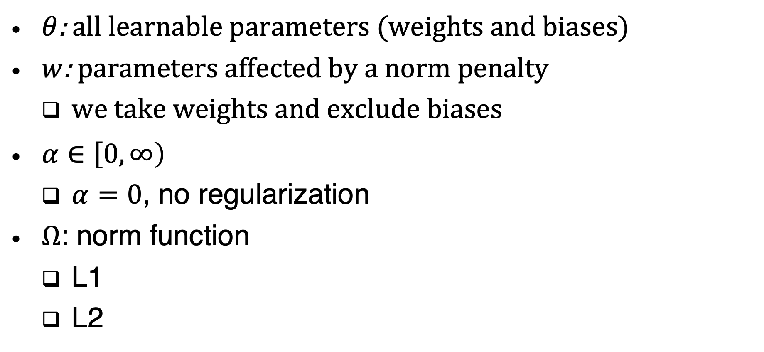
Parameter norm penalties
$θ$: all learnable parameters (weights and biases)
$w$: parameters affected by a norm penalty
we take weights and exclude biases
$α∈\left[0,∞\right)$
$α=0$, no regularization
$Ω$: norm function
L1
L2

Slide 5
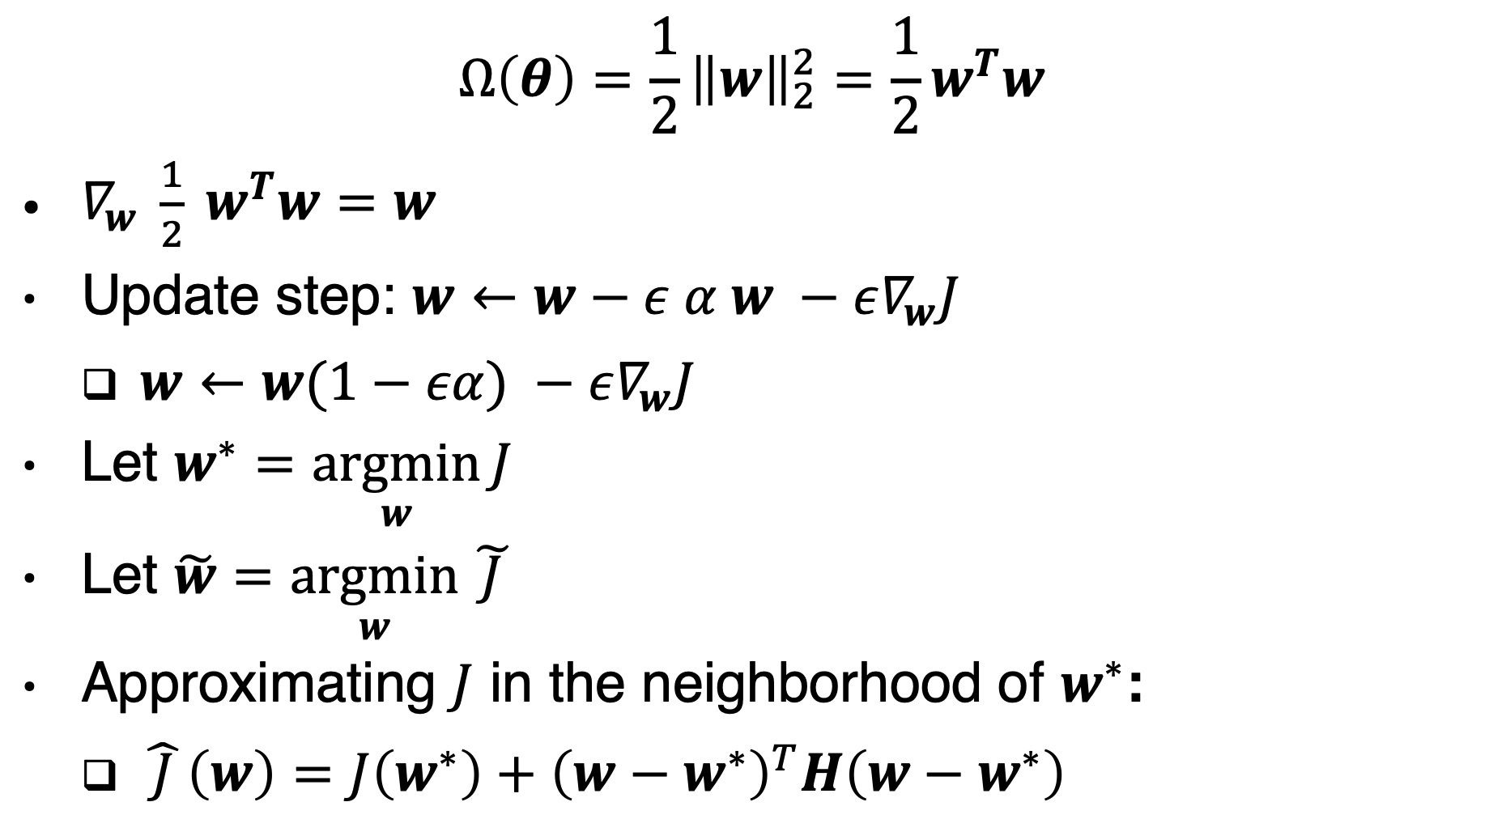

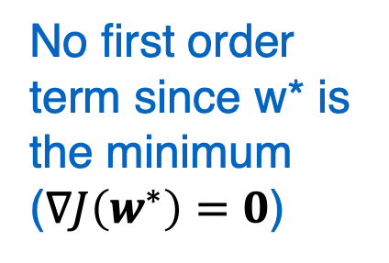
$L^{2}$Parameter regularization aka. ridge regression
$$Ω\left(θ\right)=\frac{1}{2}{\left\|w\right\|}_{2}^{2}=\frac{1}{2}w^{T}w$$
$∇_{w} \frac{1}{2} w^{T}w=w$
Update step: $w←w−ε α w −ε∇_{w}J$
$w←w(1−εα) −ε∇_{w}J$
Let $w^{∗}=\underset{w}{argmin}{J}$
Let $\tilde{w}=\underset{w}{argmin}{\tilde{ J }}$
Approximating $J$ in the neighborhood of $w^{∗}$:
$\hat{ J }\left(w\right)=J\left(w^{∗}\right)+{\left(w−w^{∗}\right)}^{T}H\left(w−w^{∗}\right)$
Weights are shrunk by a multiplicative factor
No first order term since w* is the minimum ($∇J\left(w^{∗}\right)=0$)

Slide 6
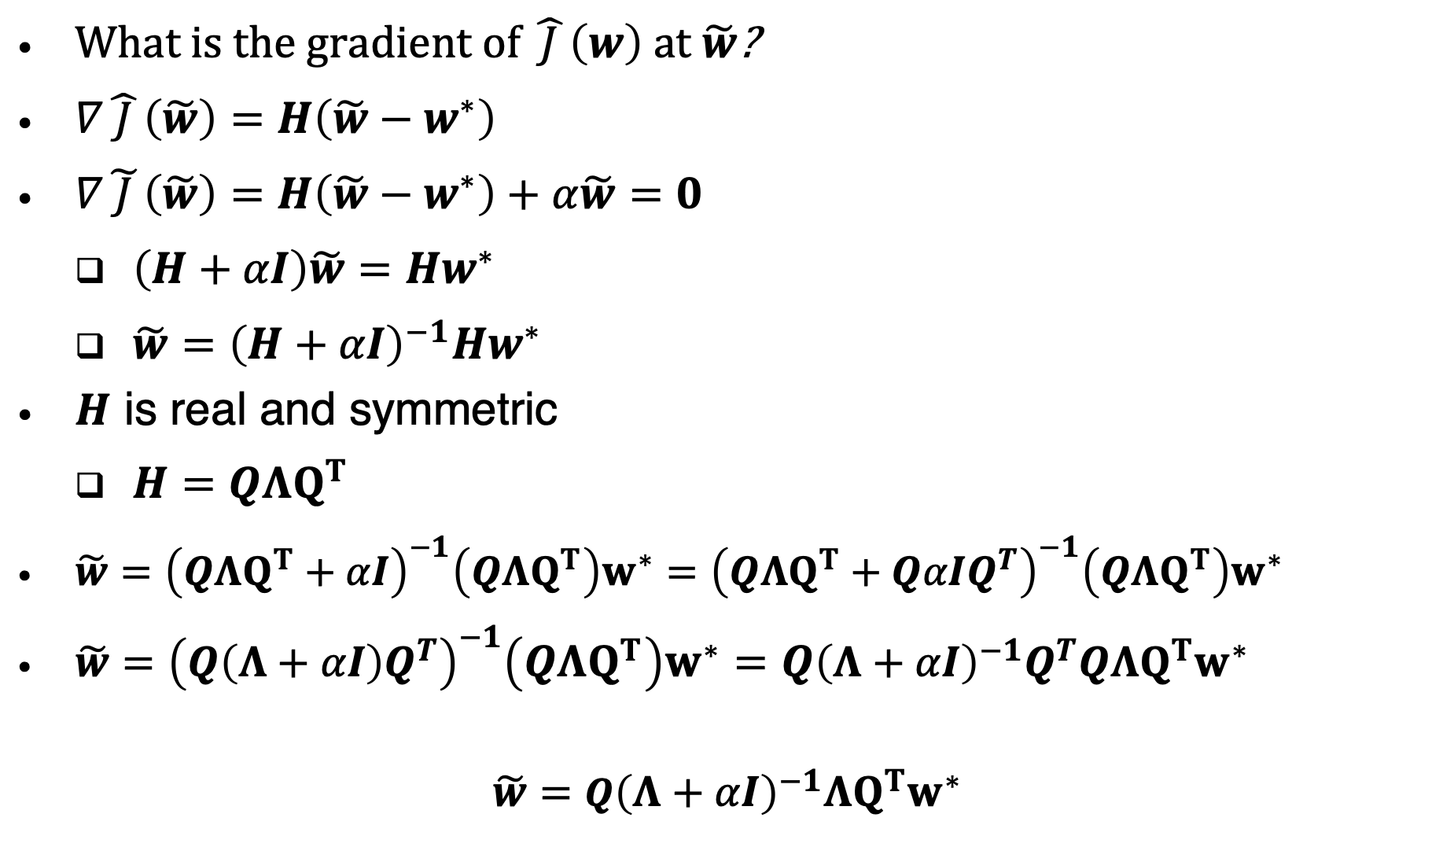
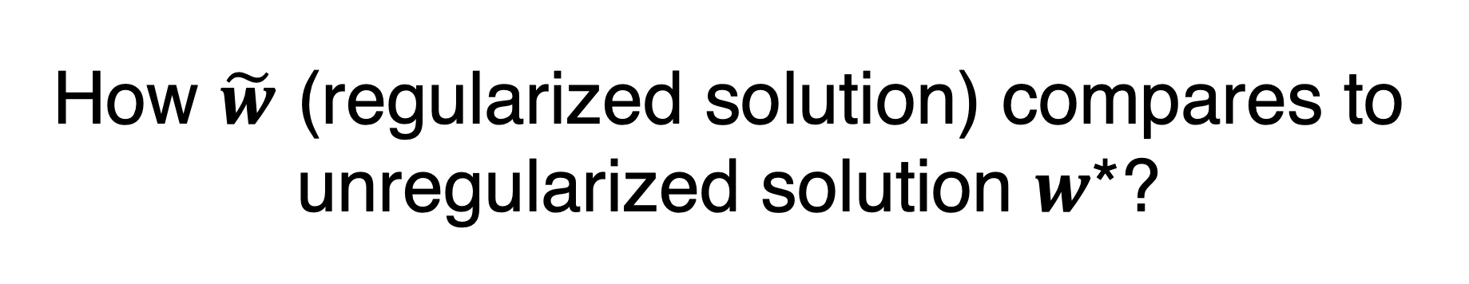
How $\tilde{w}$ (regularized solution) compares to unregularized solution $w$*?
What is the gradient of $\hat{ J }\left(w\right)$ at $\tilde{w}$?
$∇\hat{ J }\left(\tilde{w}\right)=H\left(\tilde{w}−w^{∗}\right)$
$∇\tilde{ J }\left(\tilde{w}\right)=H\left(\tilde{w}−w^{∗}\right)+α\tilde{w}=0$
$\left(H+αI\right)\tilde{w}={Hw}^{∗}$
$\tilde{w}={\left(H+αI\right)}^{−1}{Hw}^{∗}$
$H$ is real and symmetric
$H=QΛQ^{T}$
$\tilde{w}={\left(QΛQ^{T}+αI\right)}^{−1}\left(QΛQ^{T}\right)w^{∗}={\left(QΛQ^{T}+QαIQ^{T}\right)}^{−1}\left(QΛQ^{T}\right)w^{∗}$
$\tilde{w}={\left(Q\left(Λ+αI\right)Q^{T}\right)}^{−1}\left(QΛQ^{T}\right)w^{∗}=Q{\left(Λ+αI\right)}^{−1}Q^{T}QΛQ^{T}w^{∗}$
$\tilde{w}=$ $Q{\left(Λ+αI\right)}^{−1}ΛQ^{T}w^{∗}$

Slide 7
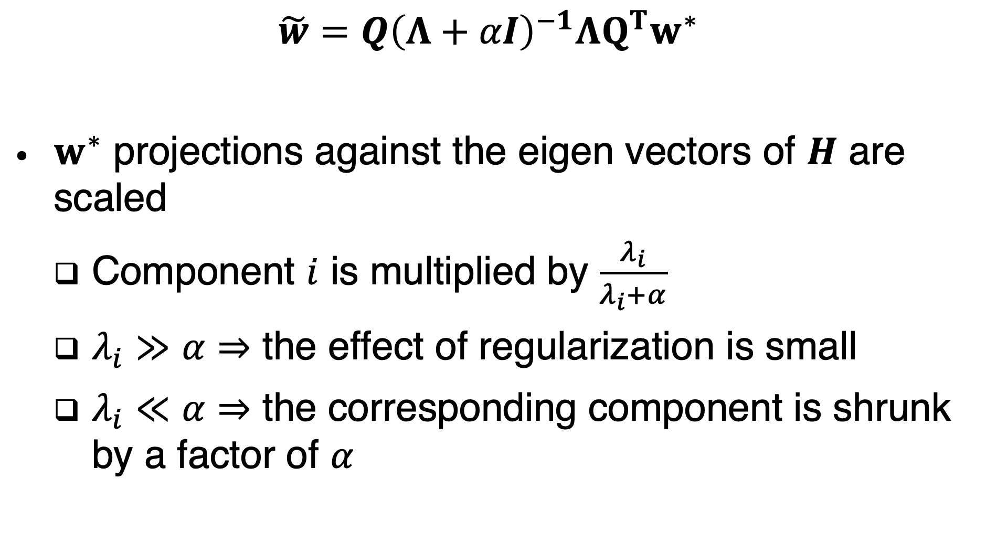
Interpretation
$\tilde{w}=$ $Q{\left(Λ+αI\right)}^{−1}ΛQ^{T}w^{∗}$
$w^{∗}$ projections against the eigen vectors of $H$ are scaled
Component $i$ is multiplied by $\frac{λ_{i}}{λ_{i}+α}$
$λ_{i}≫α⇒$ the effect of regularization is small
$λ_{i}≪α⇒$ the corresponding component is shrunk by a factor of $α$

Slide 8
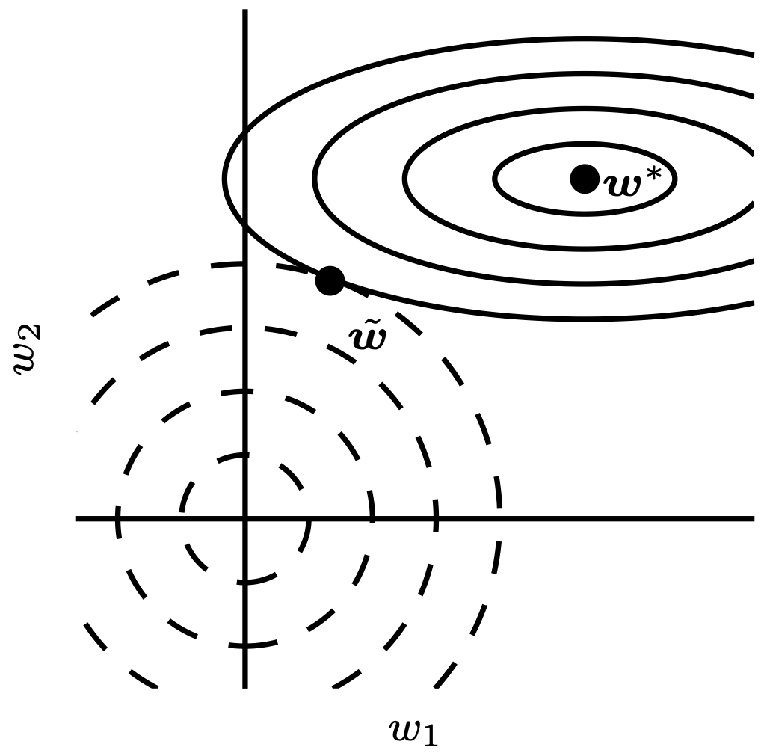
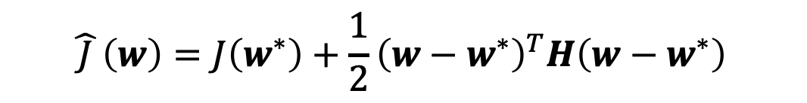

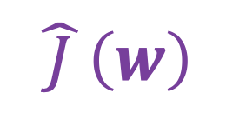
Weight Decay
$$\hat{ J }\left(w\right)=J\left(w^{∗}\right)+\frac{1}{2}{\left(w−w^{∗}\right)}^{T}H\left(w−w^{∗}\right)$$
Small Eigen vector of H
(regularization effect is large)
Unregularized solution
$$\hat{ J }\left(w\right)$$
Large Eigen vector of H
(regularization effect is small)
$$αw^{T}w$$
Regularized solution
Figure 7.1

Slide 9
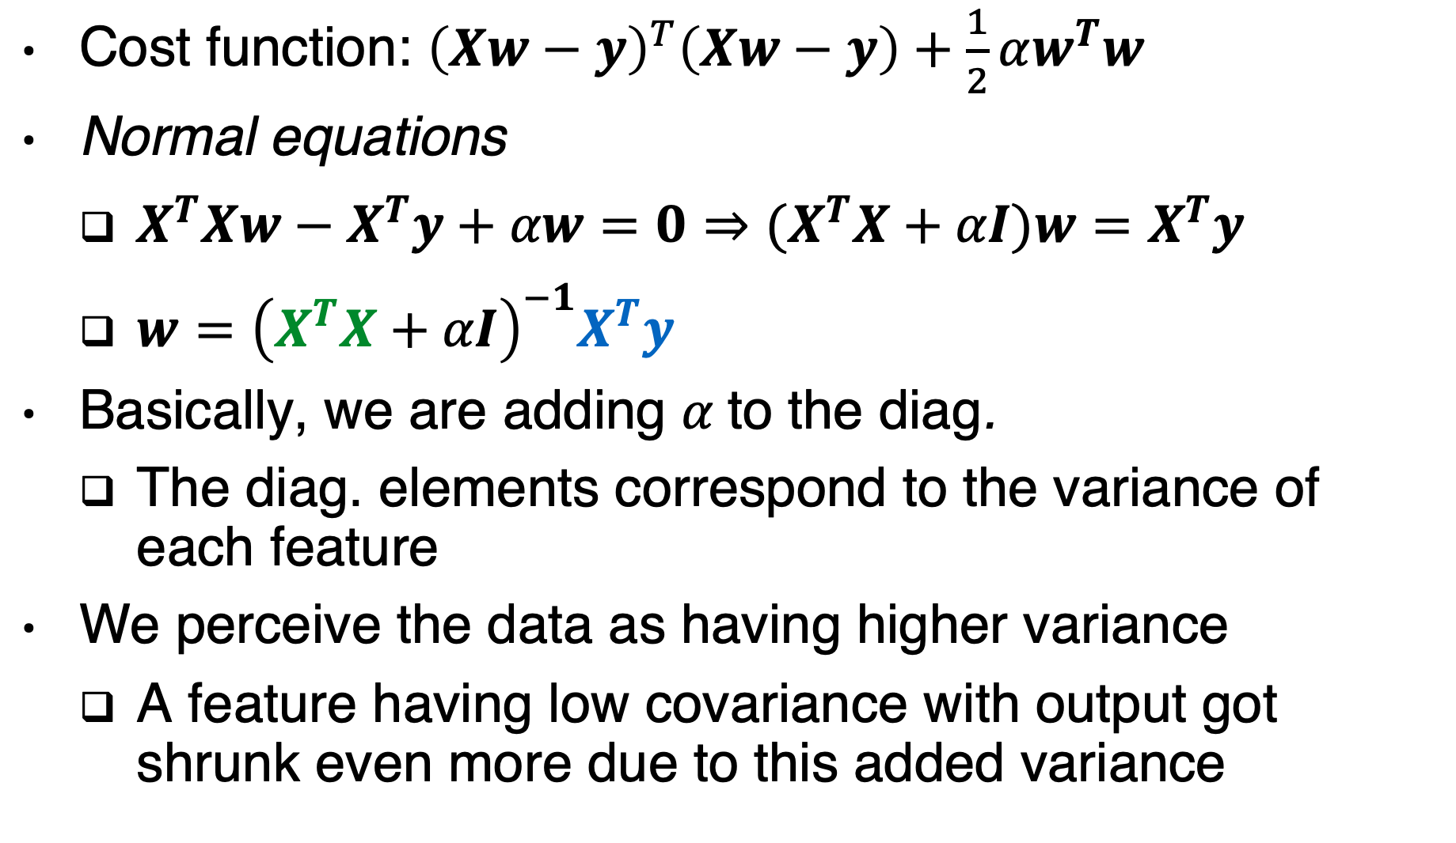
Special case: Linear Regression
Cost function: ${\left(Xw−y\right)}^{T}\left(Xw−y\right)+\frac{1}{2}αw^{T}w$
Normal equations
$X^{T}Xw−X^{T}y+αw=0⇒(X^{T}X+αI)w=X^{T}y$
$w={\left(X^{T}X+αI\right)}^{−1}X^{T}y$
Basically, we are adding $α$to the diag.
The diag. elements correspond to the variance of each feature
We perceive the data as having higher variance
A feature having low covariance with output got shrunk even more due to this added variance
Covariance feature-output
Proportional to the covariance matrix

Slide 10

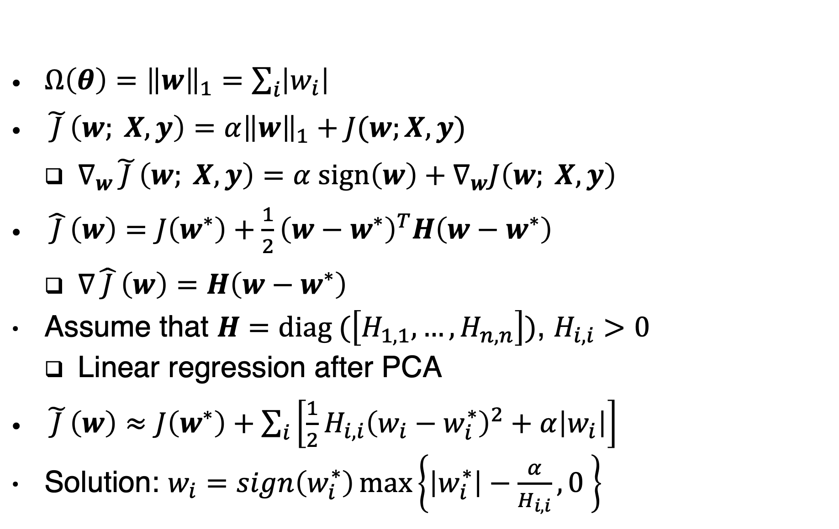
$L^{1}$ regularization
$Ω\left(θ\right)={\left\|w\right\|}_{1}=\sum_{i}{\left|w_{i}\right| }$
$\tilde{ J }\left(w; X, y\right)=α{\left\|w\right\|}_{1}+J(w;X, y)$
$∇_{w}\tilde{ J }\left(w; X, y\right)=α sign\left(w\right)+∇_{w}J\left(w; X, y\right)$
$\hat{ J }\left(w\right)=J\left(w^{∗}\right)+\frac{1}{2}{\left(w−w^{∗}\right)}^{T}H\left(w−w^{∗}\right)$
$∇\hat{ J }\left(w\right)=H\left(w−w^{∗}\right)$
Assume that $H=diag (\left[H_{1,1}, …, H_{n,n}\right])$, $H_{i,i}>0$
Linear regression after PCA
$\tilde{ J }\left(w\right)≈J\left(w^{∗}\right)+\sum_{i}{\left[\frac{1}{2}{H_{i,i}\left(w_{i}−w_{i}^{∗}\right)}^{2}+α\left|w_{i}\right|\right]}$
Solution: $w_{i}=sign\left(w_{i}^{∗}\right)\max\left\{\left|w_{i}^{∗}\right|−\frac{α}{H_{i,i}},0 \right\}$
Notes:
H is diagonal holds if the data for the linear regression problem has been
preprocessed to remove all correlation between the input features, which may be
accomplished using PCA.

Slide 11
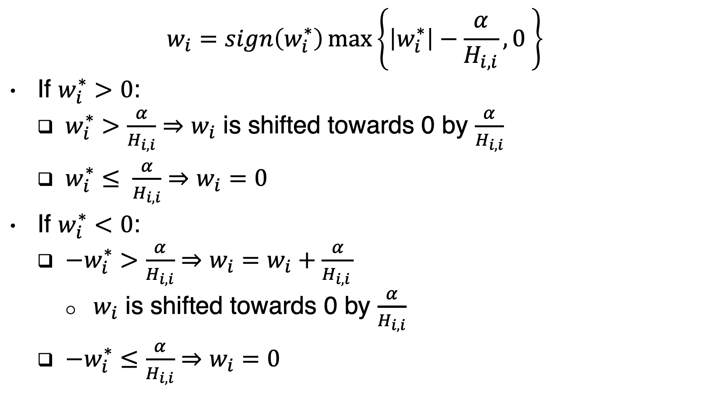
Interpretation
$$w_{i}=sign\left(w_{i}^{∗}\right)\max\left\{\left|w_{i}^{∗}\right|−\frac{α}{H_{i,i}},0 \right\}$$
If $w_{i}^{∗}>0$:
$w_{i}^{∗}>\frac{α}{H_{i,i}}⇒w_{i}$ is shifted towards 0 by $\frac{α}{H_{i,i}}$
$w_{i}^{∗}≤ \frac{α}{H_{i,i}}⇒w_{i}=0$
If $w_{i}^{∗}<0$:
$−w_{i}^{∗}>\frac{α}{H_{i,i}}⇒w_{i}=w_{i}+\frac{α}{H_{i,i }}$
$w_{i}$ is shifted towards 0 by $\frac{α}{H_{i,i}}$
$−w_{i}^{∗}≤\frac{α}{H_{i,i}}⇒w_{i}=0$

Slide 12
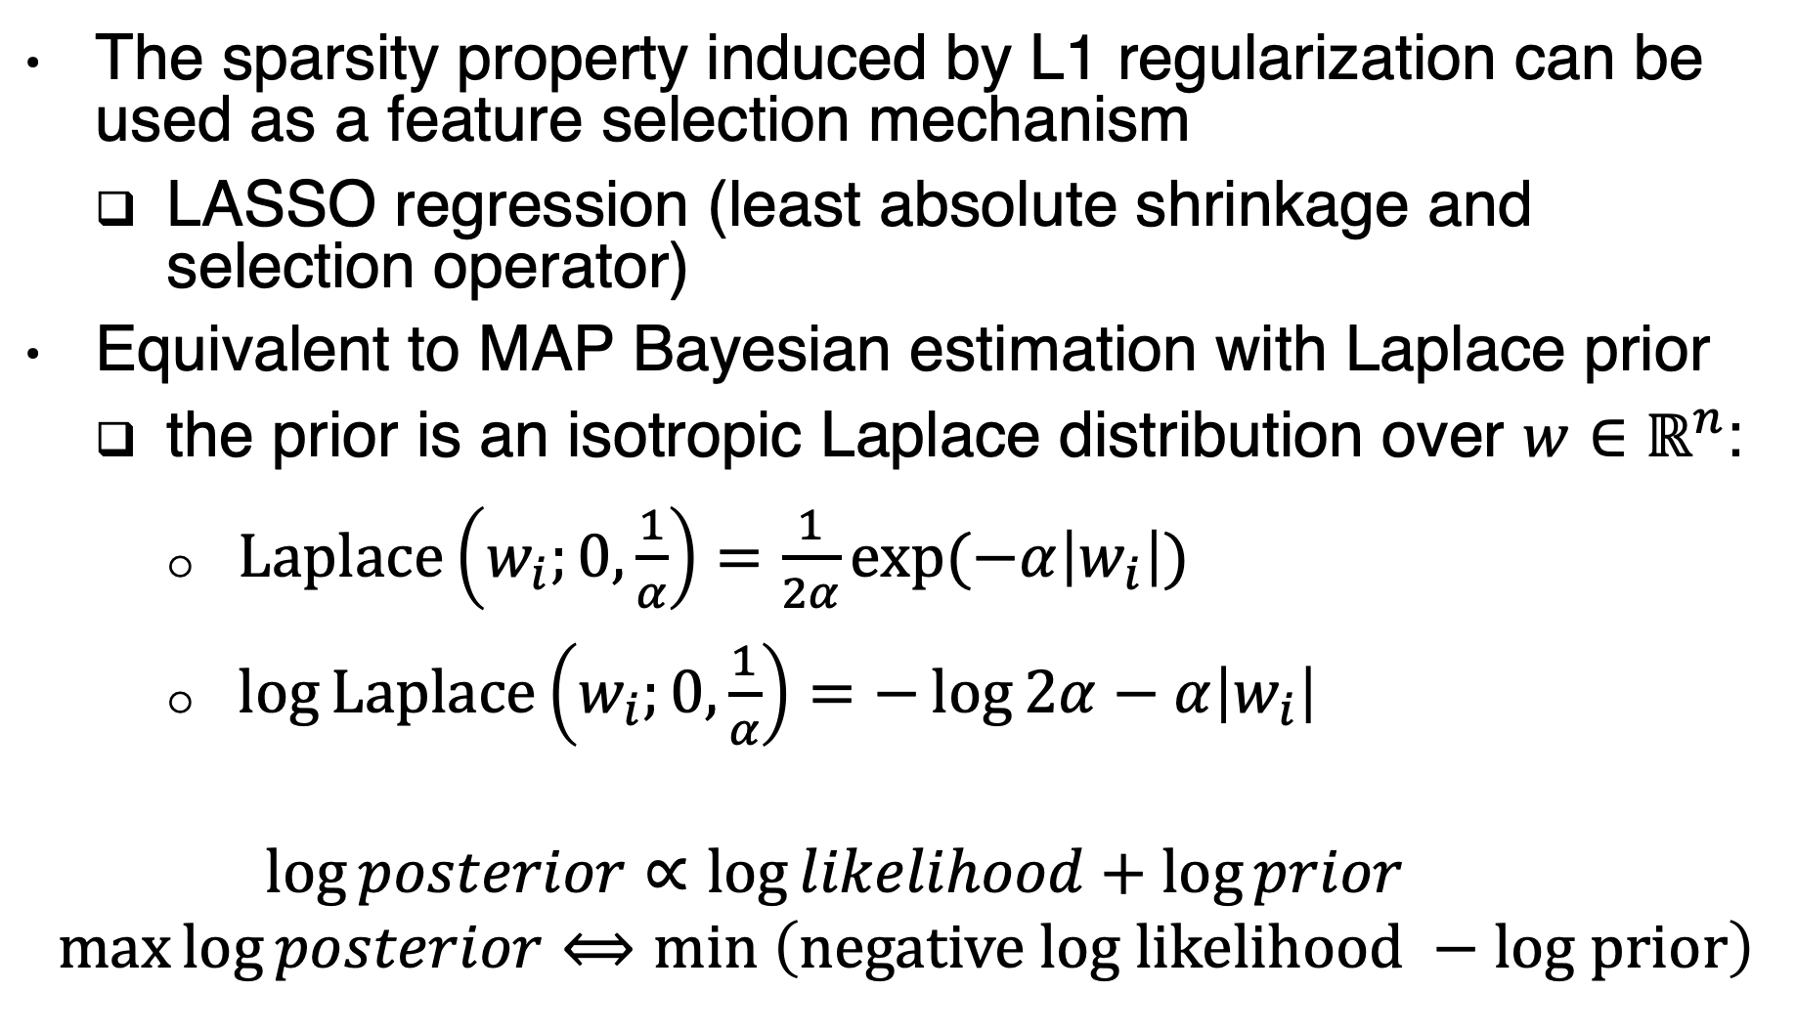
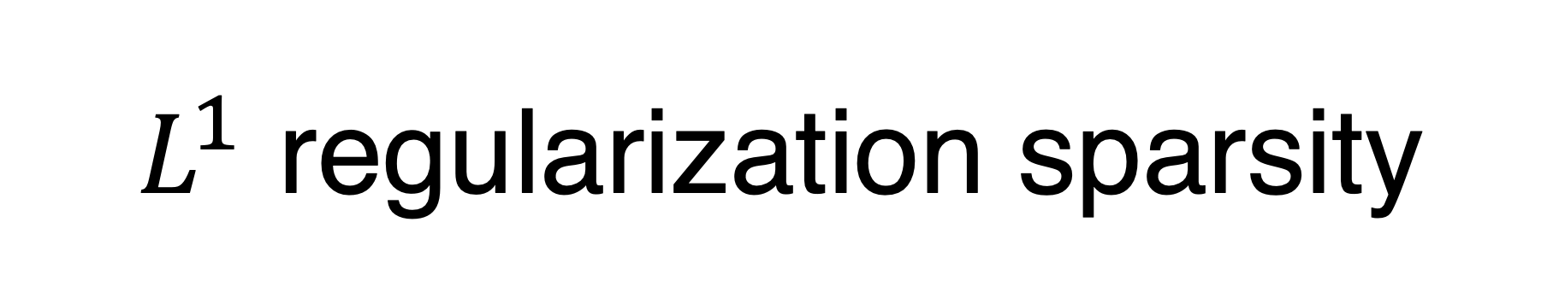
$L^{1}$ regularization sparsity
The sparsity property induced by L1 regularization can be used as a feature selection mechanism
LASSO regression (least absolute shrinkage and selection operator)
Equivalent to MAP Bayesian estimation with Laplace prior
the prior is an isotropic Laplace distribution over $w∈ℝ^{n}$:
$Laplace\left(w_{i};0,\frac{1}{α}\right)=\frac{1}{2α}\exp{(−α\left|w_{i}\right|)}$
$\log{Laplace\left(w_{i};0,\frac{1}{α}\right)}=−\log{2α}−α\left|w_{i}\right|$
$$\log{posterior∝\log{likelihood}}+\log{prior}$$
$$\max{\log{posterior}}⟺min \left(negative log likelihood −log prior\right)$$

Slide 13
Norm Penalties
MAP: Maximum A-Posteriori
L1:
Encourages sparsity,
equivalent to MAP Bayesian estimation with Laplace prior
Squared L2:
Encourages small weights,
equivalent to MAP Bayesian estimation with Gaussian prior

Slide 14
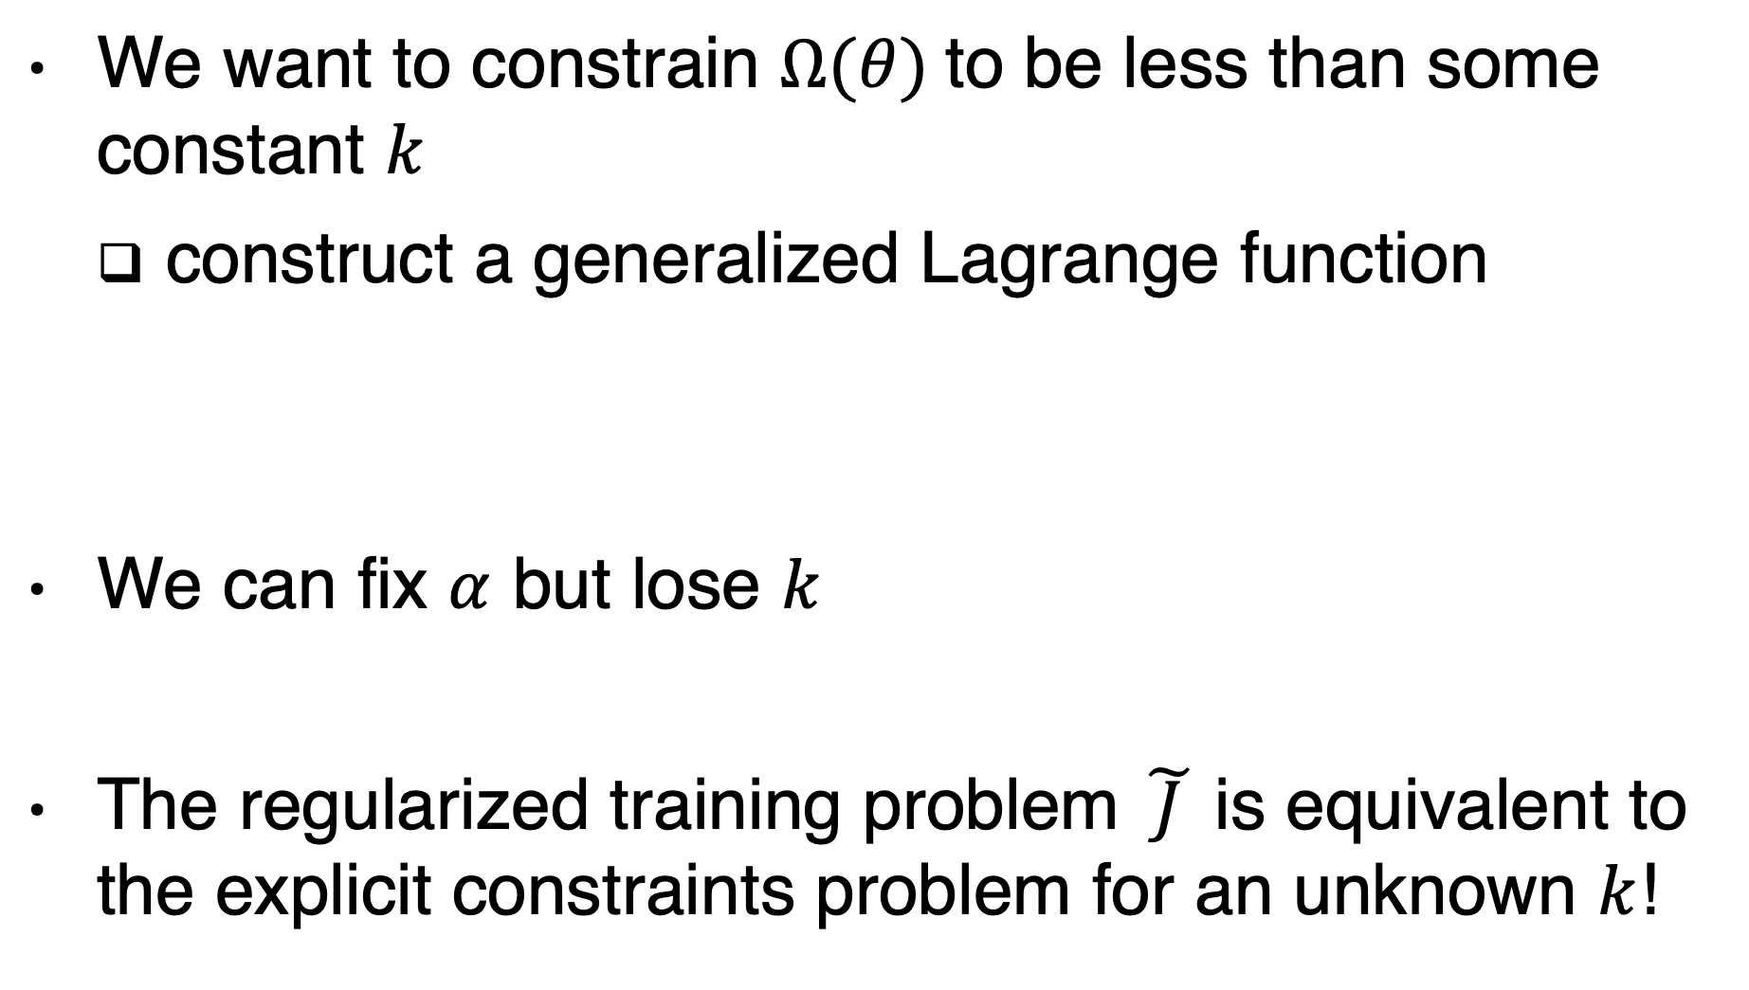
Explicit constraints
We want to constrain $Ω(θ)$to be less than some constant $k$
construct a generalized Lagrange function
We can fix $α$ but lose $k$
The regularized training problem $\tilde{ J }$is equivalent to the explicit constraints problem for an unknown $k$!
Notes:
https://www.khanacademy.org/math/multivariable-calculus/applications-of-multivariable-derivatives/lagrange-multipliers-and-constrained-optimization/v/constrained-optimization-introduction
take a step downhill on J (θ) and then project θ back to the nearest point that satisfies Ω(θ) < k.

Slide 15
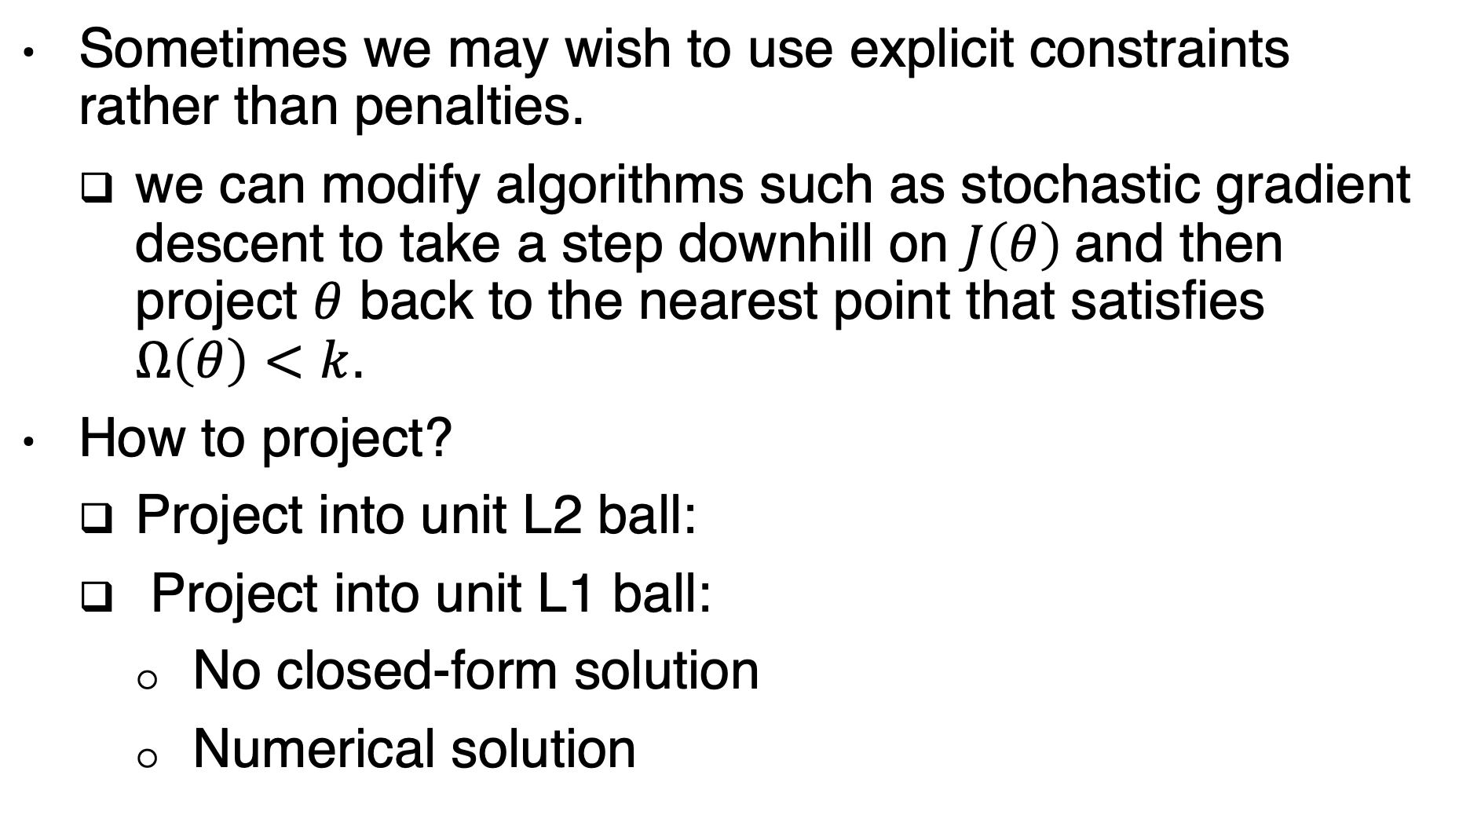
Projection
Sometimes we may wish to use explicit constraints rather than penalties.
we can modify algorithms such as stochastic gradient descent to take a step downhill on $J\left(θ\right)$and then project $θ$ back to the nearest point that satisfies $Ω\left(θ\right)<k$.
How to project?
Project into unit L2 ball:
Project into unit L1 ball:
No closed-form solution
Numerical solution
Notes:
https://angms.science/doc/CVX/Proj_l2.pdf
https://angms.science/doc/CVX/Proj_l1.pdf

Slide 16
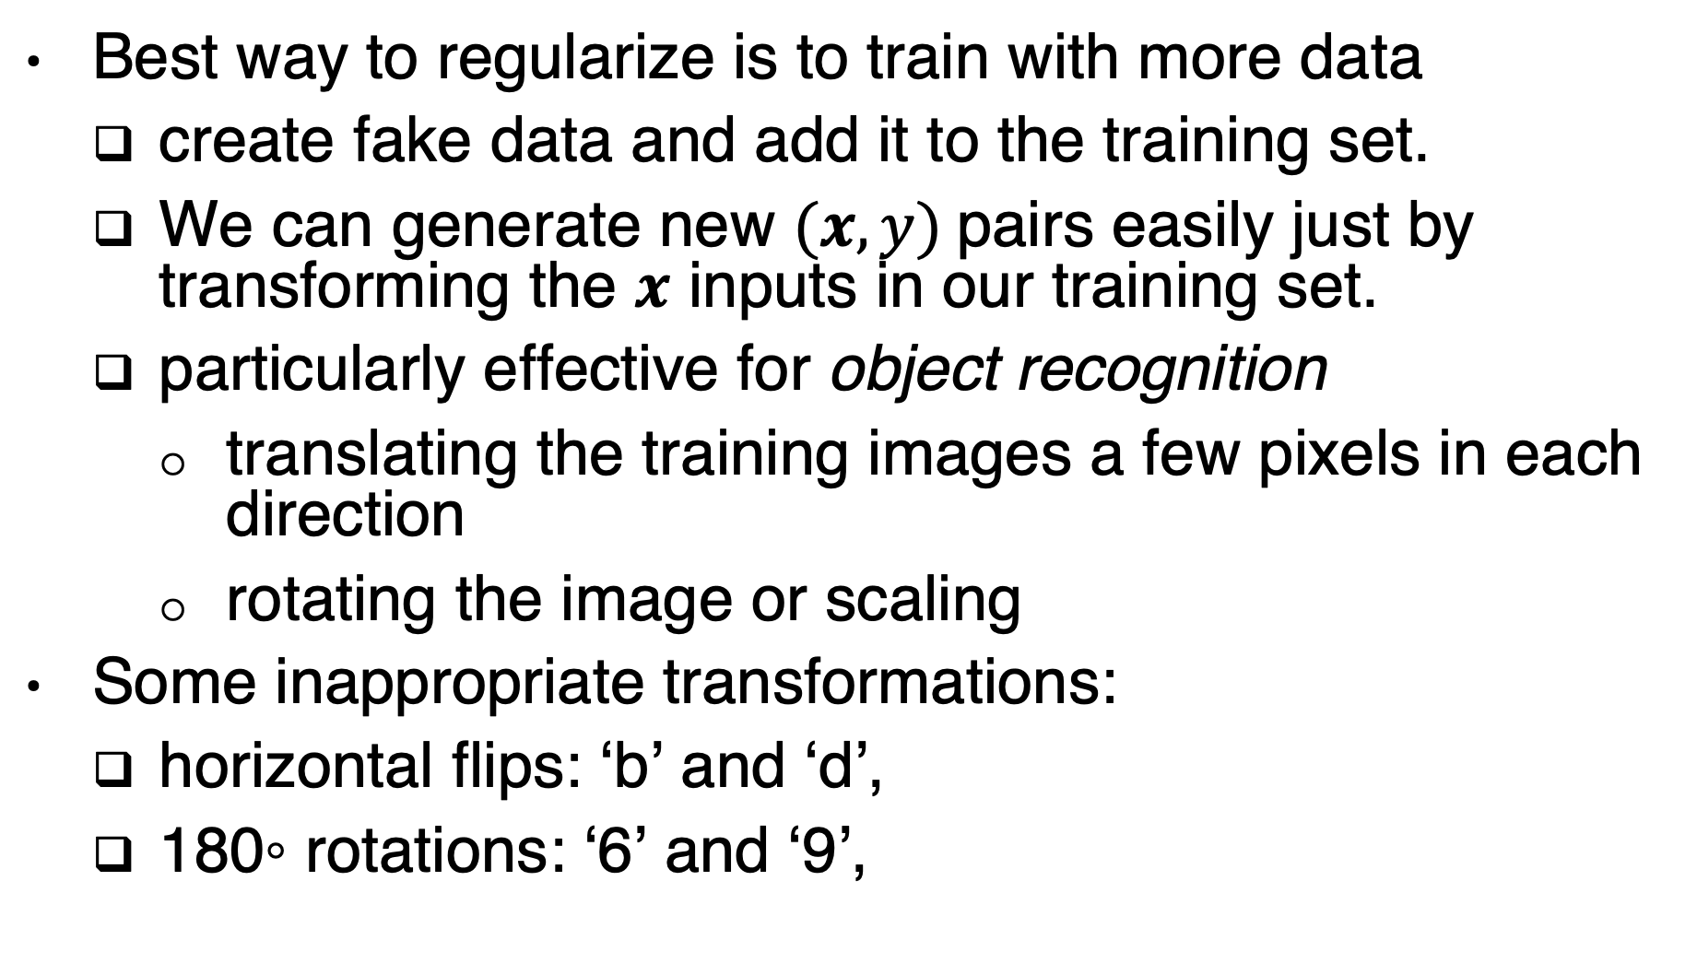
Dataset Augmentation
Best way to regularize is to train with more data
create fake data and add it to the training set.
We can generate new $(x, y)$pairs easily just by transforming the $x$ inputs in our training set.
particularly effective for object recognition
translating the training images a few pixels in each direction
rotating the image or scaling
Some inappropriate transformations:
horizontal flips: ‘b’ and ‘d’,
180◦ rotations: ‘6’ and ‘9’,

Slide 17

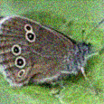



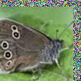

Dataset Augmentation
Affine Distortion
Elastic Deformation
Noise
Horizontal flip
Random Translation
Hue Shift

Slide 18
Noise Robustness
Noise with infinitesimal variance can be added:
At the input
At the hidden layers
At the weights:

Slide 19
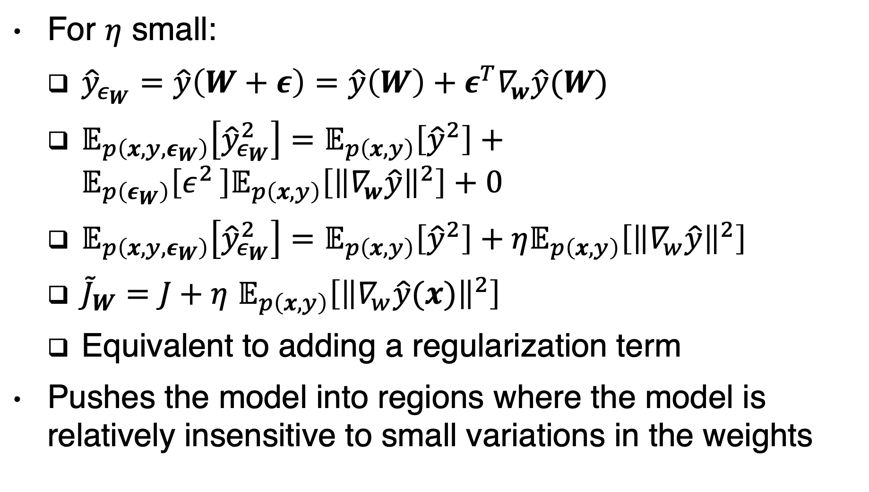
Injecting noise at the weights
For $η$ small:
${\hat{y}}_{ε_{W}}=\hat{y}\left(W+ε\right)=\hat{y}\left(W\right)+ε^{T}∇_{w}\hat{y}(W)$
$𝔼_{p\left({x,y,ε}_{W}\right)}\left[{\hat{y}}_{ε_{W}}^{2}\right]=𝔼_{p\left(x,y\right)}\left[{\hat{y}}^{2}\right]+𝔼_{p\left(ε_{W}\right)}\left[ε^{2 }\right]𝔼_{p\left(x,y\right)}\left[{\left\|∇_{w}\hat{y}\right\|}^{2}\right]+0$
$𝔼_{p\left({x,y,ε}_{W}\right)}\left[{\hat{y}}_{ε_{W}}^{2}\right]=𝔼_{p\left(x,y\right)}\left[{\hat{y}}^{2}\right]+η𝔼_{p\left(x,y\right)}\left[{\left\|∇_{w}\hat{y}\right\|}^{2}\right]$
${\tilde{J}}_{W}=J+η$ $𝔼_{p\left(x,y\right)}\left[{\left\|∇_{w}\hat{y}(x)\right\|}^{2}\right]$
Equivalent to adding a regularization term
Pushes the model into regions where the model is relatively insensitive to small variations in the weights

Slide 20
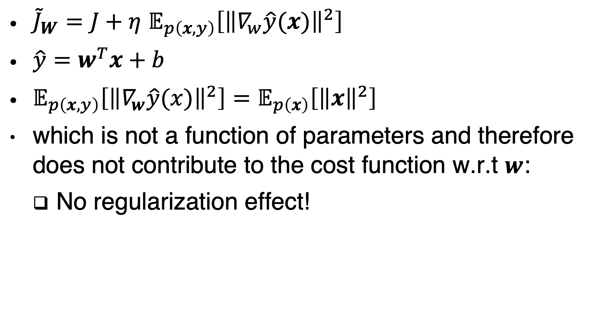
Special case: linear regression
${\tilde{J}}_{W}=J+η$ $𝔼_{p\left(x,y\right)}\left[{\left\|∇_{w}\hat{y}(x)\right\|}^{2}\right]$
$\hat{y}=w^{T}x+b$
$𝔼_{p\left(x,y\right)}\left[{\left\|∇_{w}\hat{y}(x)\right\|}^{2}\right]=𝔼_{p\left(x\right)}\left[{\left\|x\right\|}^{2}\right]$
which is not a function of parameters and therefore does not contribute to the cost function w.r.t $w$:
No regularization effect!

Slide 21
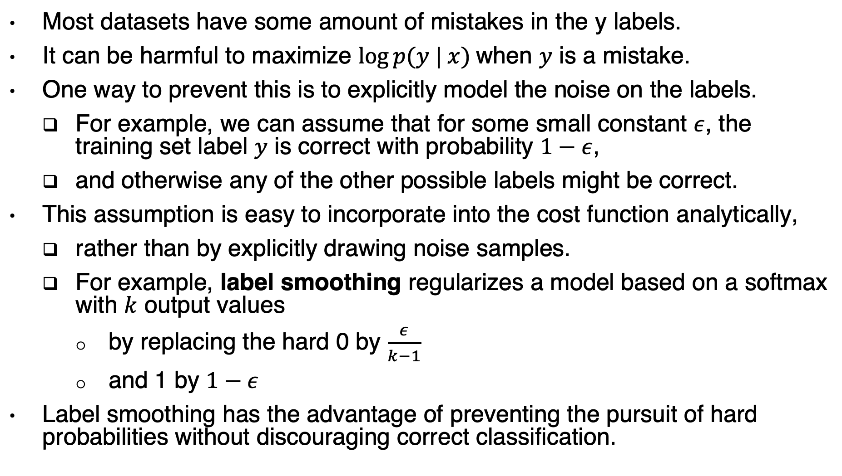
Injecting noise at the output targets
Most datasets have some amount of mistakes in the y labels.
It can be harmful to maximize $log⁡p(y | x)$when $y$ is a mistake.
One way to prevent this is to explicitly model the noise on the labels.
For example, we can assume that for some small constant $ε$, the training set label $y$ is correct with probability $1−ε$,
and otherwise any of the other possible labels might be correct.
This assumption is easy to incorporate into the cost function analytically,
rather than by explicitly drawing noise samples.
For example, label smoothing regularizes a model based on a softmax with $k$ output values
by replacing the hard 0 by $\frac{ε}{k−1}$
and 1 by $1−ε$
Label smoothing has the advantage of preventing the pursuit of hard probabilities without discouraging correct classification.

Slide 22
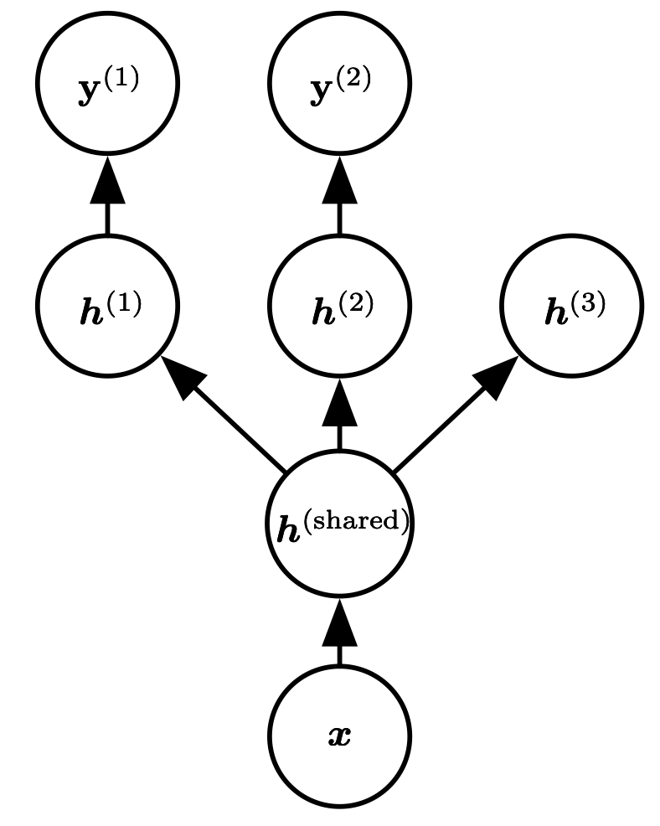
Multi-Task Learning
Unsupervised Learning context
Task specific parameters
Among the factors that explain the variations observed in the data
associated with the different tasks, some are shared across two or more tasks.
Figure 7.2

Slide 23
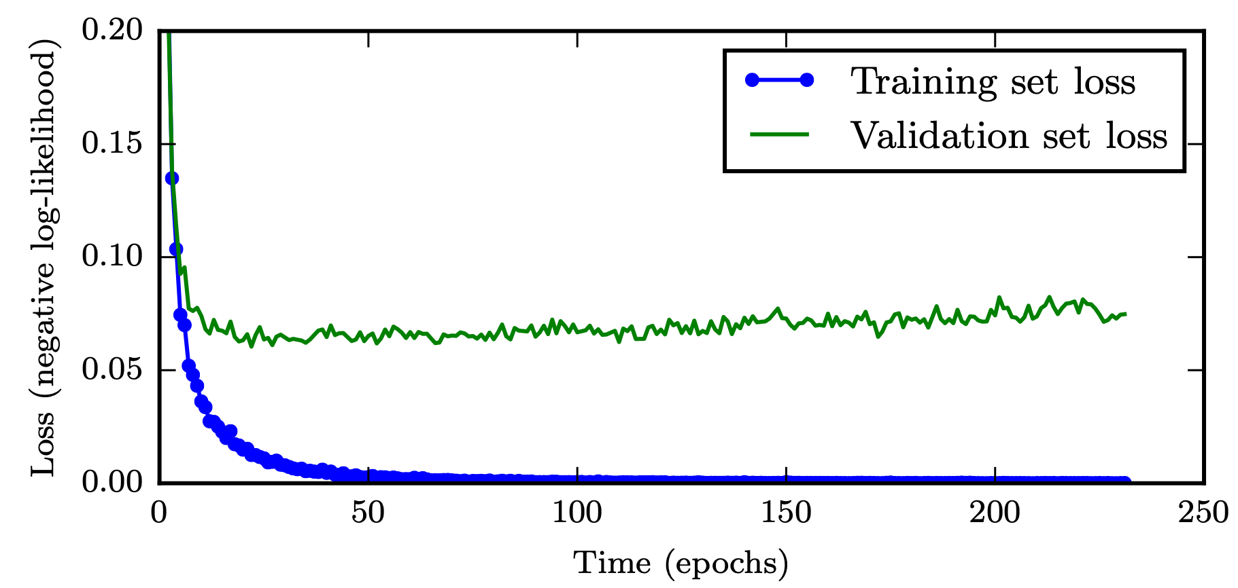
Learning Curves
Early stopping: terminate while validation set
performance is better
Figure 7.3

Slide 24
Early stopping
probably the most commonly used form of regularization in deep learning.
the number of training steps (or training time) is just another hyperparameter.
The cost is running the validation set evaluation periodically during training
Reduce the validation set
Evaluate the validation loss less frequently
Periodically save the trained model

Slide 25
Early stopping algorithm

Slide 26
Re-use the validation set
Less well-behaved

Slide 27
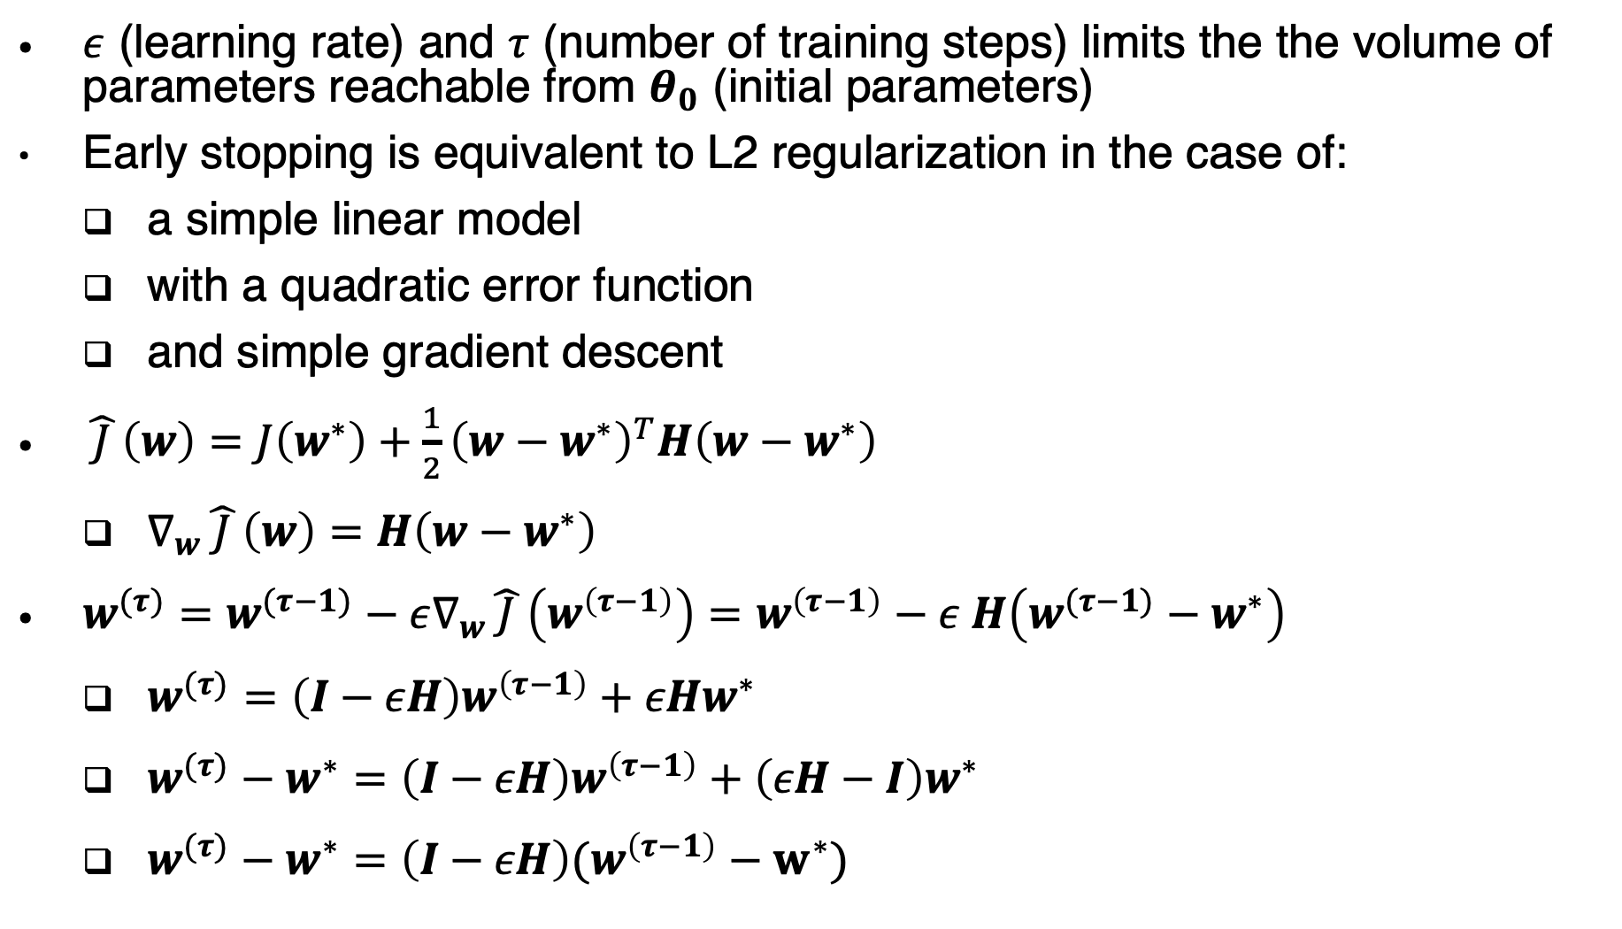
Early stopping as a regularizer
$ε$ (learning rate) and $τ$ (number of training steps) limits the the volume of parameters reachable from $θ_{0}$ (initial parameters)
Early stopping is equivalent to L2 regularization in the case of:
a simple linear model
with a quadratic error function
and simple gradient descent
$\hat{ J }\left(w\right)=J\left(w^{∗}\right)+\frac{1}{2}{\left(w−w^{∗}\right)}^{T}H\left(w−w^{∗}\right)$
$∇_{w}\hat{ J }\left(w\right)=H\left(w−w^{∗}\right)$
$w^{(τ)}=w^{(τ−1)}−ε∇_{w}\hat{ J }\left(w^{\left(τ−1\right)}\right)=w^{\left(τ−1\right)}−ε H\left(w^{(τ−1)}−w^{∗}\right)$
$w^{(τ)}=\left(I−εH\right)w^{\left(τ−1\right)}+εHw^{∗}$
$w^{(τ)}−w^{∗}=\left(I−εH\right)w^{\left(τ−1\right)}+\left(εH−I\right)w^{∗}$
$w^{(τ)}−w^{∗}=\left(I−εH\right)(w^{\left(τ−1\right)}−w^{∗})$

Slide 28
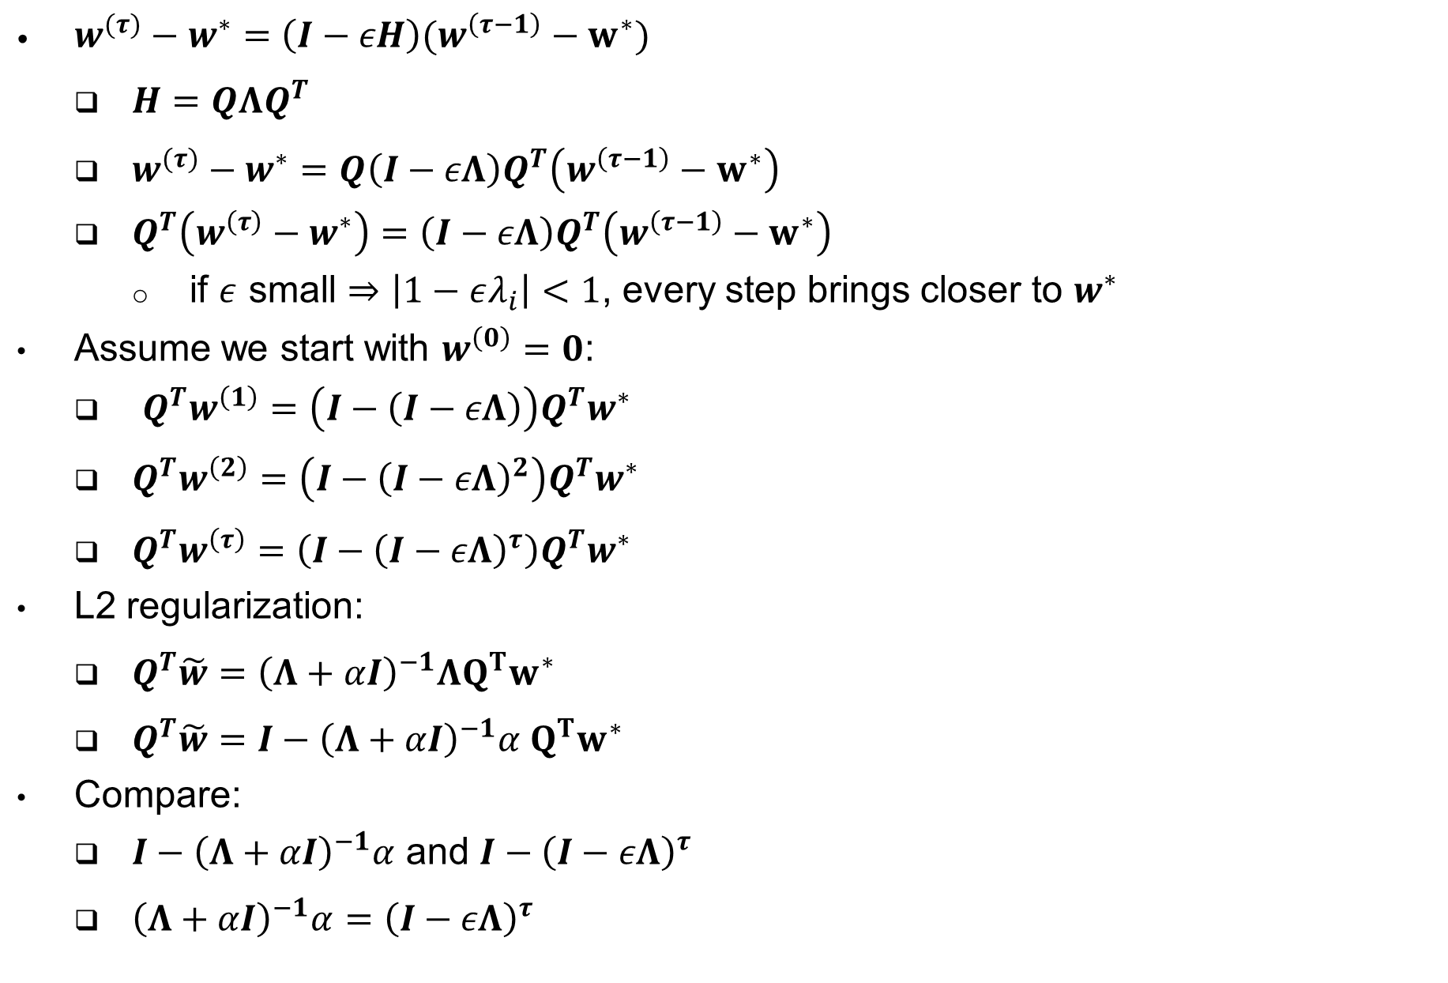
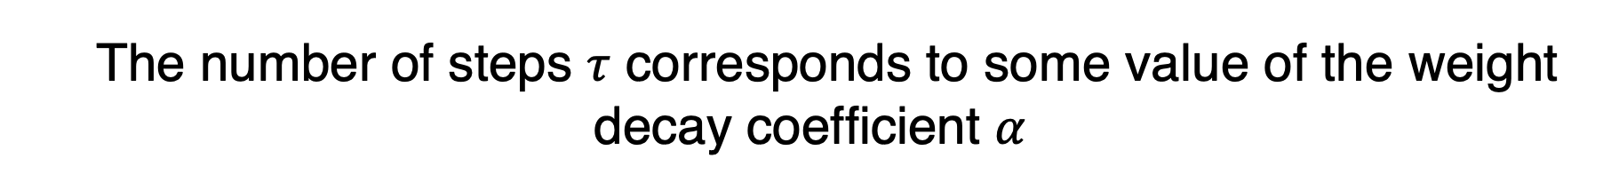
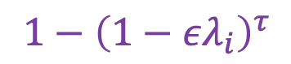
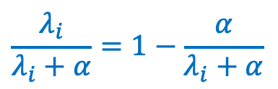
The number of steps $τ$ corresponds to some value of the weight decay coefficient $α$
$w^{(τ)}−w^{∗}=\left(I−εH\right)(w^{\left(τ−1\right)}−w^{∗})$
$H=QΛQ^{T}$
$w^{(τ)}−w^{∗}=Q\left(I−εΛ\right)Q^{T}\left(w^{\left(τ−1\right)}−w^{∗}\right)$
$Q^{T}\left(w^{\left(τ\right)}−w^{∗}\right)=$ $\left(I−εΛ\right)Q^{T}\left(w^{\left(τ−1\right)}−w^{∗}\right)$
if $ε$ small $⇒\left|1−ελ_{i}\right|<1$, every step brings closer to $w^{∗}$
Assume we start with $w^{\left(0\right)}=0$:
$Q^{T}w^{\left(1\right)}=\left(I−\left(I−εΛ\right)\right)Q^{T}w^{∗}$
$Q^{T}w^{\left(2\right)}=\left(I−{\left(I−εΛ\right)}^{2}\right)Q^{T}w^{∗}$
$Q^{T}w^{\left(τ\right)}=\left(I−{\left(I−εΛ\right)}^{τ}\right)Q^{T}w^{∗}$
L2 regularization:
$Q^{T}\tilde{w}={\left(Λ+αI\right)}^{−1}ΛQ^{T}w^{∗}$
$Q^{T}\tilde{w}={I−\left(Λ+αI\right)}^{−1}α Q^{T}w^{∗}$
Compare:
${I−\left(Λ+αI\right)}^{−1}α$ and $I−{\left(I−εΛ\right)}^{τ}$
${\left(Λ+αI\right)}^{−1}α={\left(I−εΛ\right)}^{τ}$
$$\frac{λ_{i}}{λ_{i}+α}=1−\frac{α}{λ_{i}+α}$$
$1−{\left(1−ελ_{i}\right)}^{τ}$

Slide 29
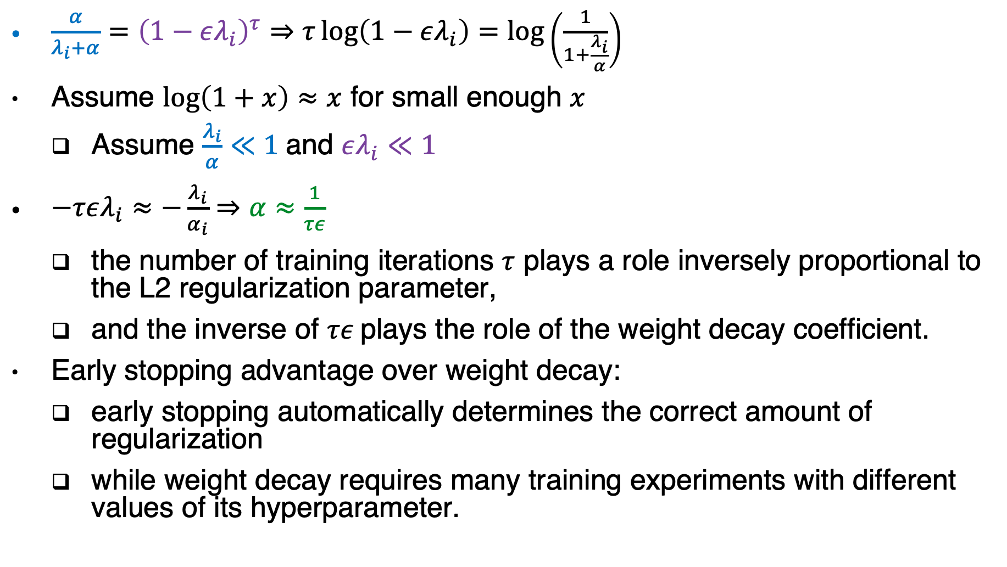
Early stopping advantage
$\frac{α}{λ_{i}+α}={\left(1−ελ_{i}\right)}^{τ}⇒τ\log\left(1−ελ_{i}\right)=\log\left(\frac{1}{1+\frac{λ_{i}}{α}}\right)$
Assume $\log\left(1+x\right)≈x$ for small enough $x$
Assume $\frac{λ_{i}}{α}≪1$and $ελ_{i}≪1$
$−τελ_{i}≈−\frac{λ_{i}}{α_{i}}⇒α≈\frac{1}{τε}$
the number of training iterations $τ$ plays a role inversely proportional to the L2 regularization parameter,
and the inverse of $τε$plays the role of the weight decay coefficient.
Early stopping advantage over weight decay:
early stopping automatically determines the correct amount of regularization
while weight decay requires many training experiments with different values of its hyperparameter.

Slide 30
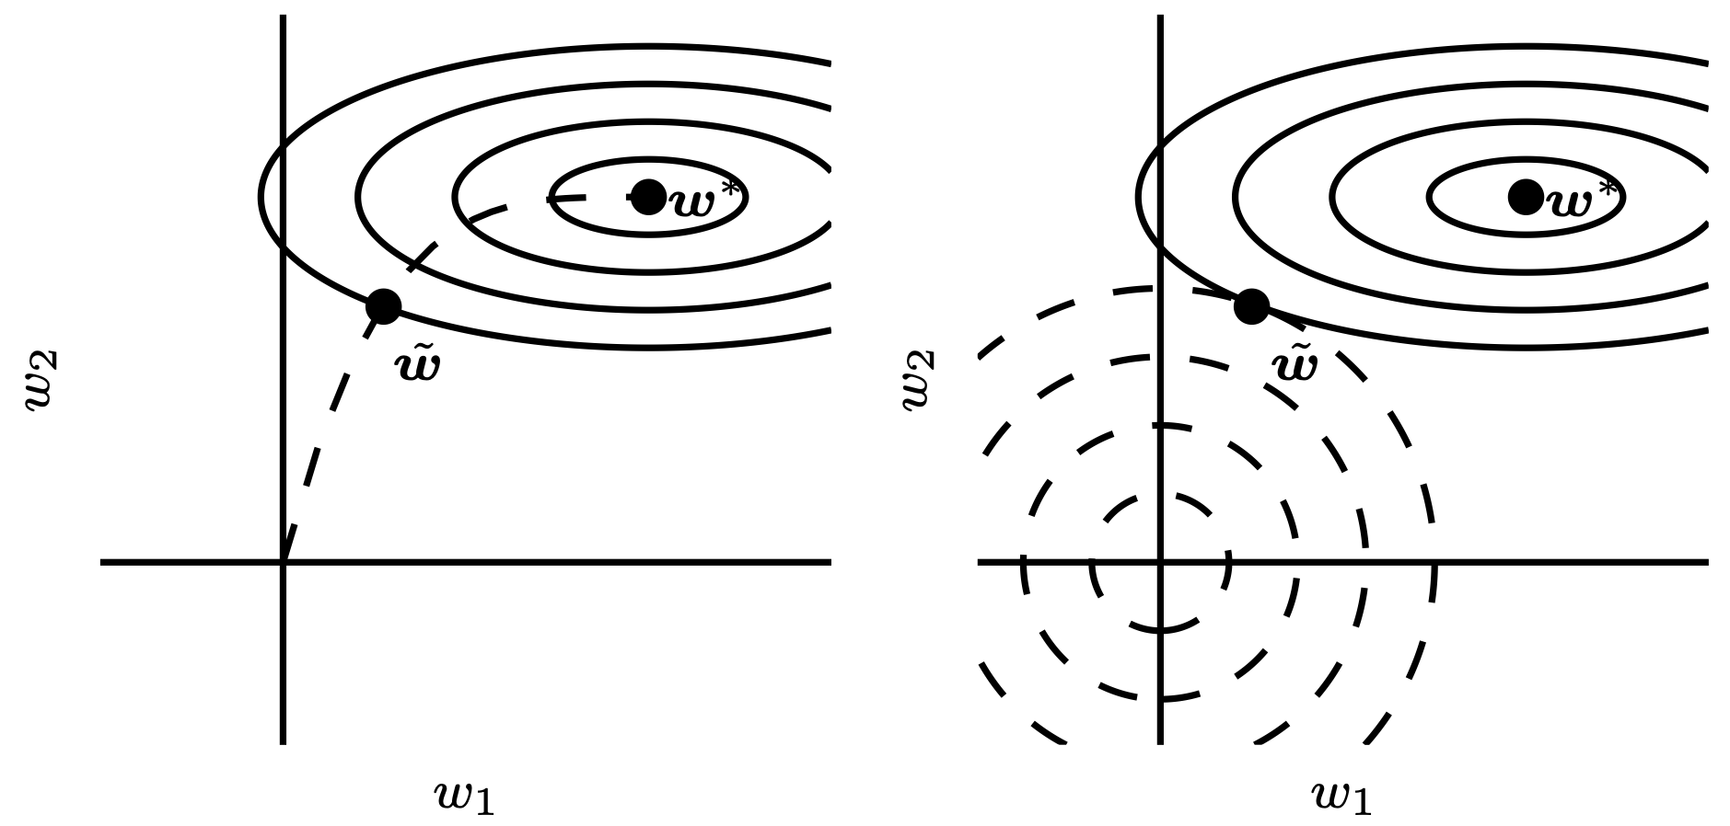
Early Stopping and Weight Decay
Figure 7.4

Slide 31
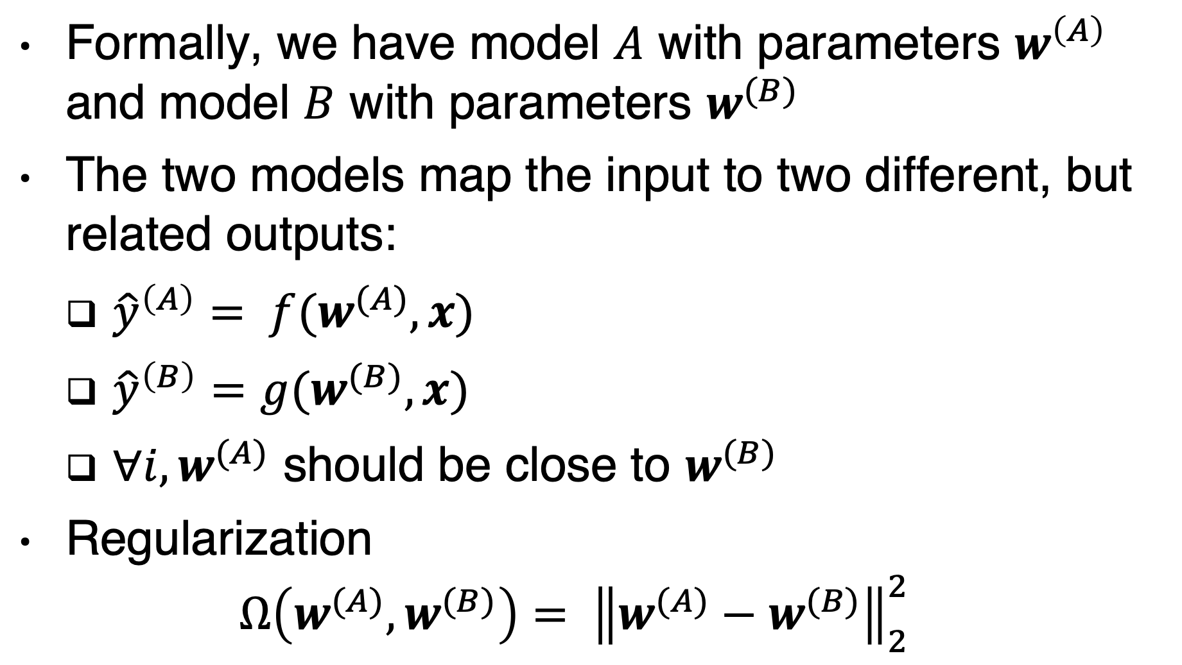
Parameter tying
Formally, we have model $A$ with parameters $w^{\left(A\right)}$ and model $B$ with parameters $w^{(B)}$
The two models map the input to two different, but related outputs:
${\hat{y}}^{\left(A\right)}= f(w^{(A)}, x)$
${\hat{y}}^{\left(B\right)}=g(w^{(B)}, x)$
$∀i,w^{(A)}$ should be close to $w^{(B)}$
Regularization
$$Ω\left(w^{(A)}, w^{(B)}\right)= {\left\|w^{(A)}−w^{(B)}\right\|}_{2}^{2}$$

Slide 32
Parameter sharing (e.g. CNN)
Force sets of parameters to be equal.
Advantage:
only a subset of the parameters (the unique set) needs to be stored in memory.
Natural images have many statistical properties that are invariant to translation.
a photo of a cat remains a photo of a cat if it is translated one pixel to the right
Parameter sharing has allowed CNNs to dramatically lower the number of unique model parameters

Slide 33
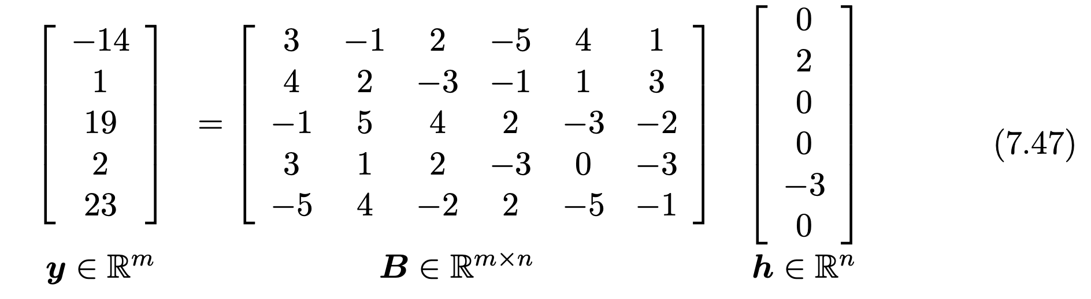
Sparse Representations
Sparse parameters
Sparse representations

Slide 34
Bagging
Bagging (short for bootstrap aggregating) is a technique for reducing generalization error by combining several models
train several different models separately
the models vote on the output for test examples
Bagging is an example of model averaging.
The general term is Ensemble methods.
The reason that model averaging works is that different models will usually not make all the same errors on the test set.

Slide 35
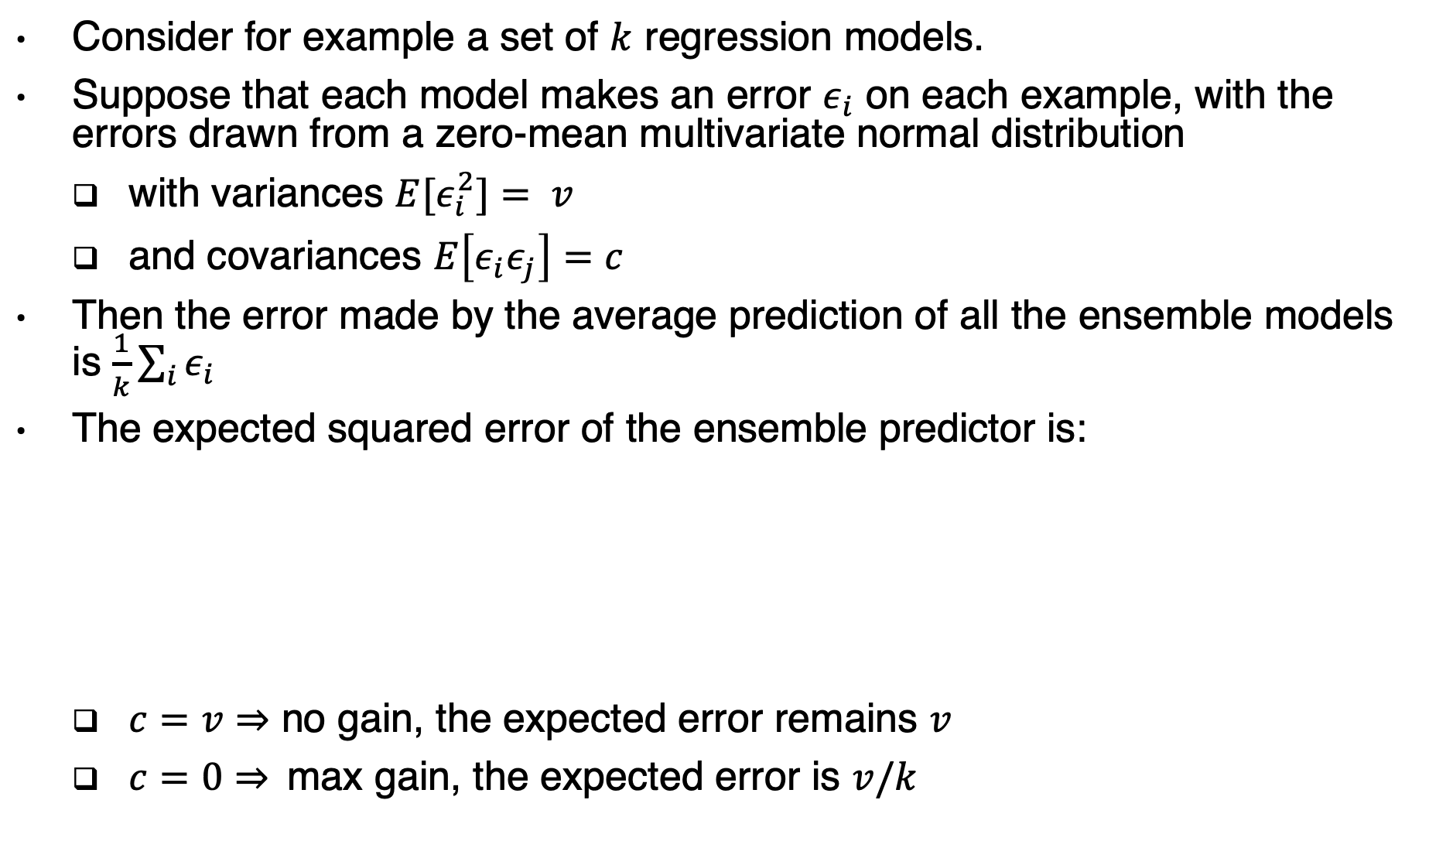
Bagging example
Consider for example a set of $k$ regression models.
Suppose that each model makes an error $ε_{i}$ on each example, with the errors drawn from a zero-mean multivariate normal distribution
with variances $E[ε_{i}^{2}]= v$
and covariances $E\left[ε_{i}ε_{j}\right]=c$
Then the error made by the average prediction of all the ensemble models is $\frac{1}{k}\sum_{i}{ε_{i}}$
The expected squared error of the ensemble predictor is:
$c=v⇒$ no gain, the expected error remains $v$
$c=0⇒$max gain, the expected error is $v/k$

Slide 36
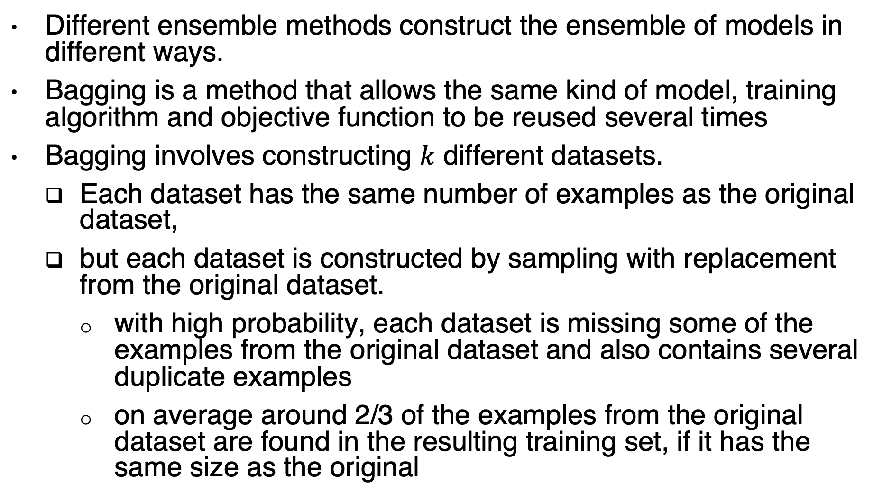
Ensemble methods vs. bagging
Different ensemble methods construct the ensemble of models in different ways.
Bagging is a method that allows the same kind of model, training algorithm and objective function to be reused several times
Bagging involves constructing $k$ different datasets.
Each dataset has the same number of examples as the original dataset,
but each dataset is constructed by sampling with replacement from the original dataset.
with high probability, each dataset is missing some of the examples from the original dataset and also contains several duplicate examples
on average around 2/3 of the examples from the original dataset are found in the resulting training set, if it has the same size as the original

Slide 37
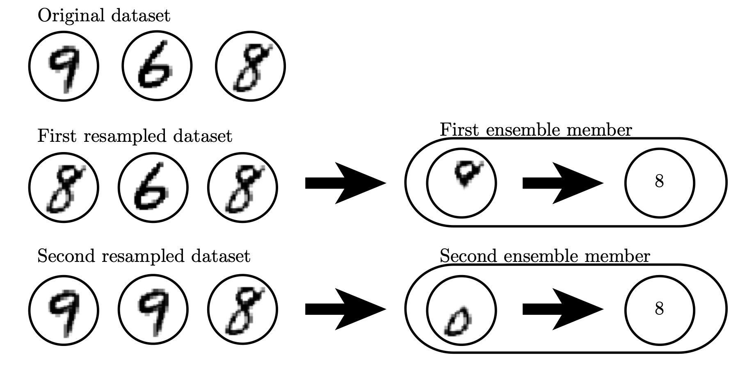
Bagging
the detector learns that a loop on top of the digit corresponds to an 8.
the detector learns
that a loop on the bottom of the digit corresponds to an 8.

Slide 38

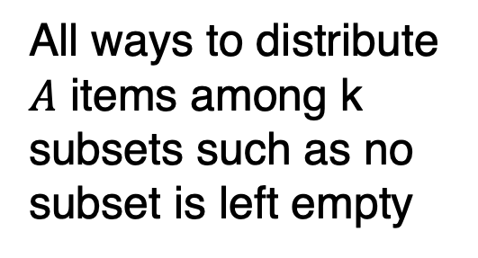
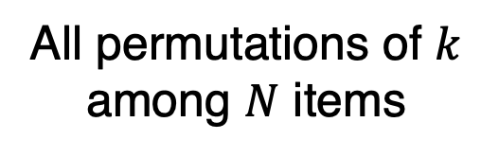
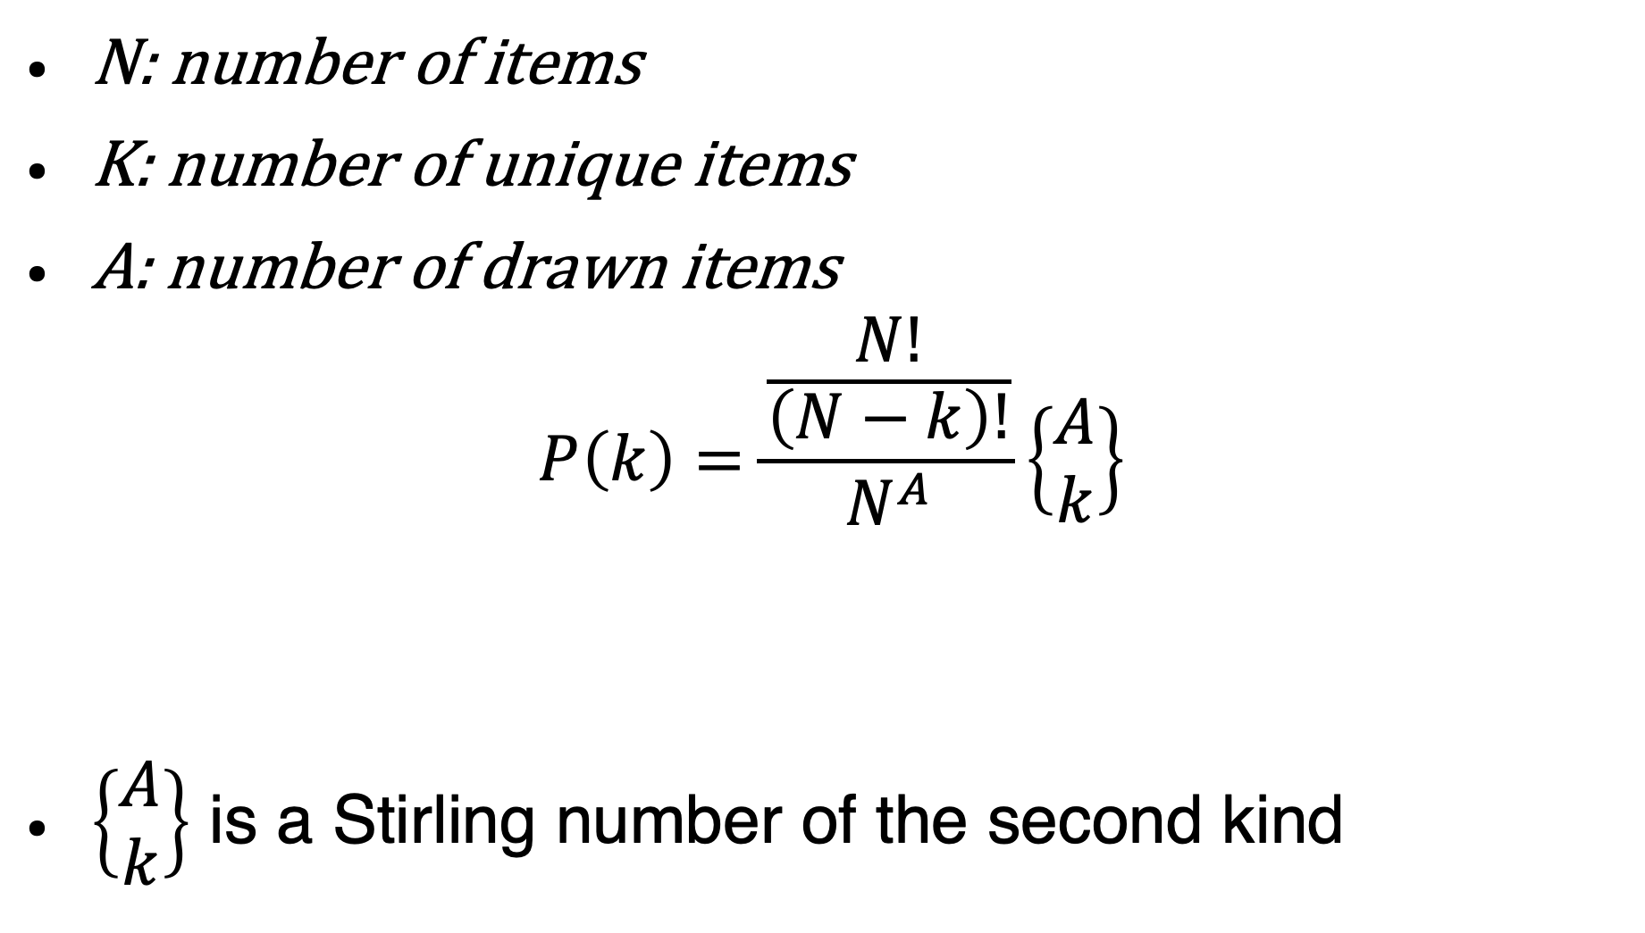
Why $2/3$ ?
N: number of items
K: number of unique items
A: number of drawn items
$$P\left(k\right)=\frac{\frac{N!}{\left(N−k\right)!}}{N^{A}}\left\{\begin{matrix}A \\ k\end{matrix}\right\}$$
$\left\{\begin{matrix}A \\ k\end{matrix}\right\}$ is a Stirling number of the second kind
All permutations of $k$ among $N$ items
All ways to distribute $A$ items among k subsets such as no subset is left empty
All possible ways to draw A items
Notes:
Reference : https://arxiv.org/pdf/1602.05822.pdf

Slide 39
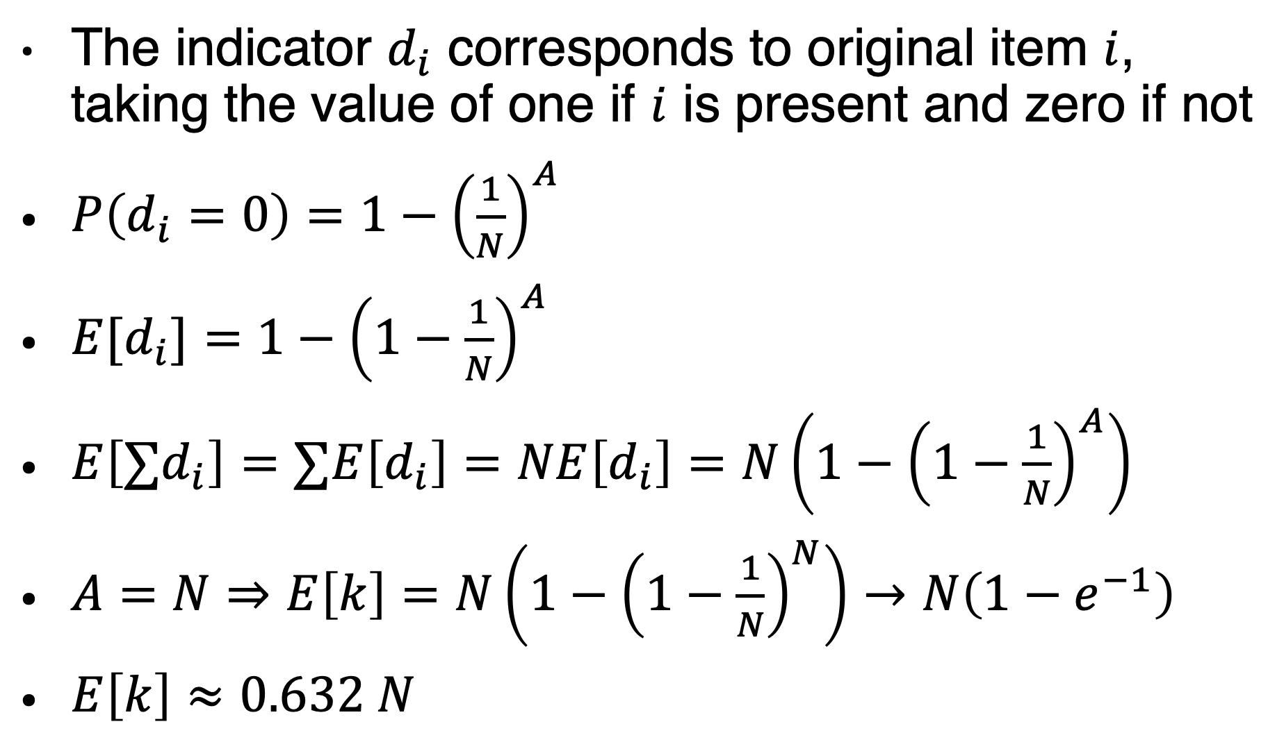
Expected number of duplicates
The indicator $d_{i}$ corresponds to original item $i$, taking the value of one if $i$ is present and zero if not
$P\left(d_{i}=0\right)=1−{\left(\frac{1}{N}\right)}^{A}$
$E[d_{i}]=1−{\left(1−\frac{1}{N}\right)}^{A}$
$E\left[∑d_{i}\right]=∑E\left[d_{i}\right]=NE\left[d_{i}\right]=N\left(1−{\left(1−\frac{1}{N}\right)}^{A}\right)$
$A=N⇒E\left[k\right]=N\left(1−{\left(1−\frac{1}{N}\right)}^{N}\right)→N\left(1−e^{−1}\right)$
$E\left[k\right]≈0.632 N$

Slide 40
More about bagging
Neural networks reach a wide enough variety of solution points that they can often benefit from model averaging
Model averaging is an extremely powerful and reliable method for reducing generalization error.
Its use is usually discouraged when benchmarking algorithms for scientific papers
Machine learning contests are usually won by methods using model averaging over dozens of models.

Slide 41
Dropout
Dropout provides an inexpensive approximation to training and evaluating a bagged ensemble of exponentially many neural networks.
removing non-output units from an underlying base network
by multiplying its output value by zero
Each time we load an example into a minibatch, we randomly sample a different binary mask to apply to all of the input and hidden units in the network.
The probability of sampling a mask value of one (causing a unit to be included) is a hyperparameter fixed before training begins.
Typically, an input unit is included with probability 0.8 and a hidden unit is included with probability 0.5

Slide 42
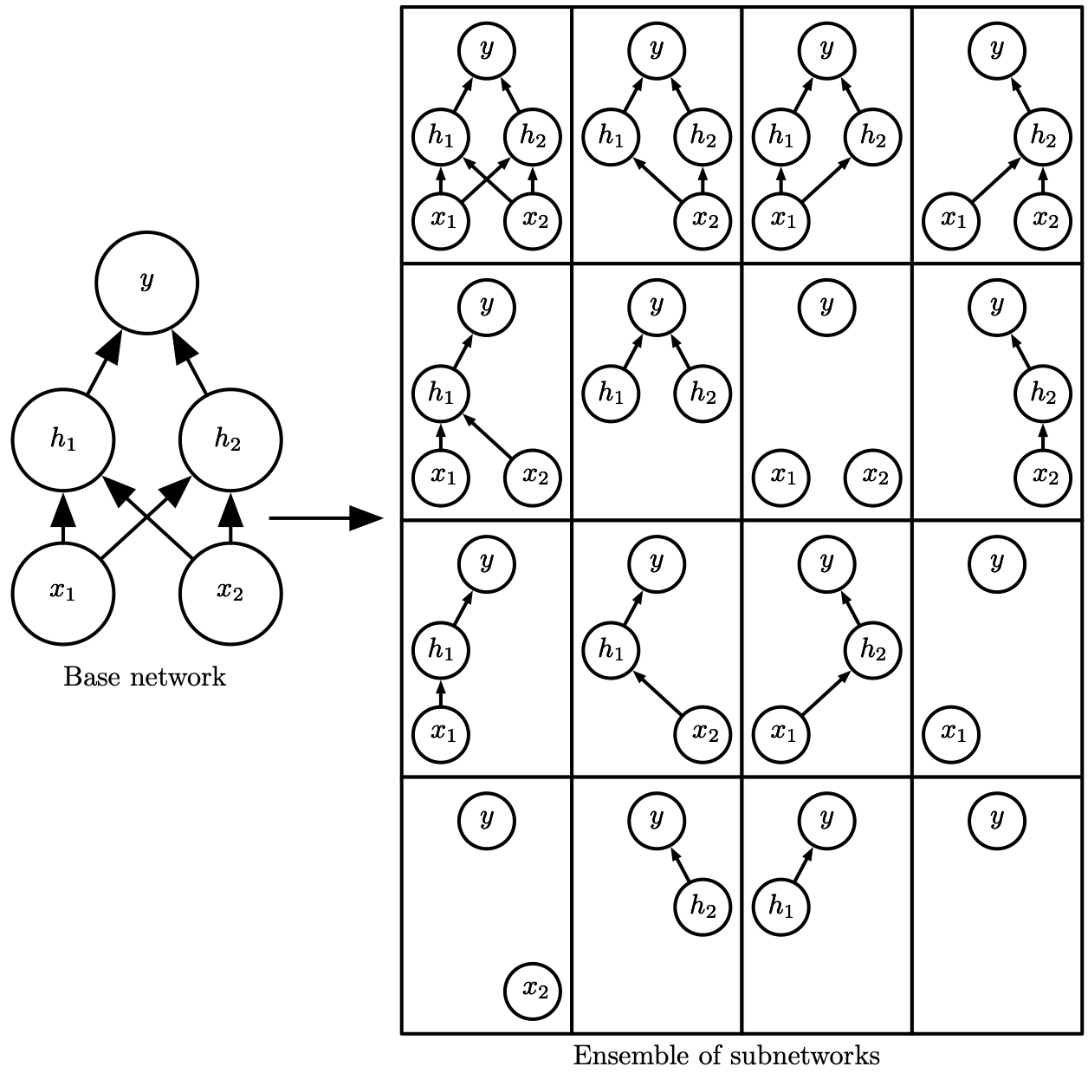
Dropout
Figure 7.6
In networks with wider layers, the probability of dropping all possible paths from inputs to outputs becomes smaller.

Slide 43
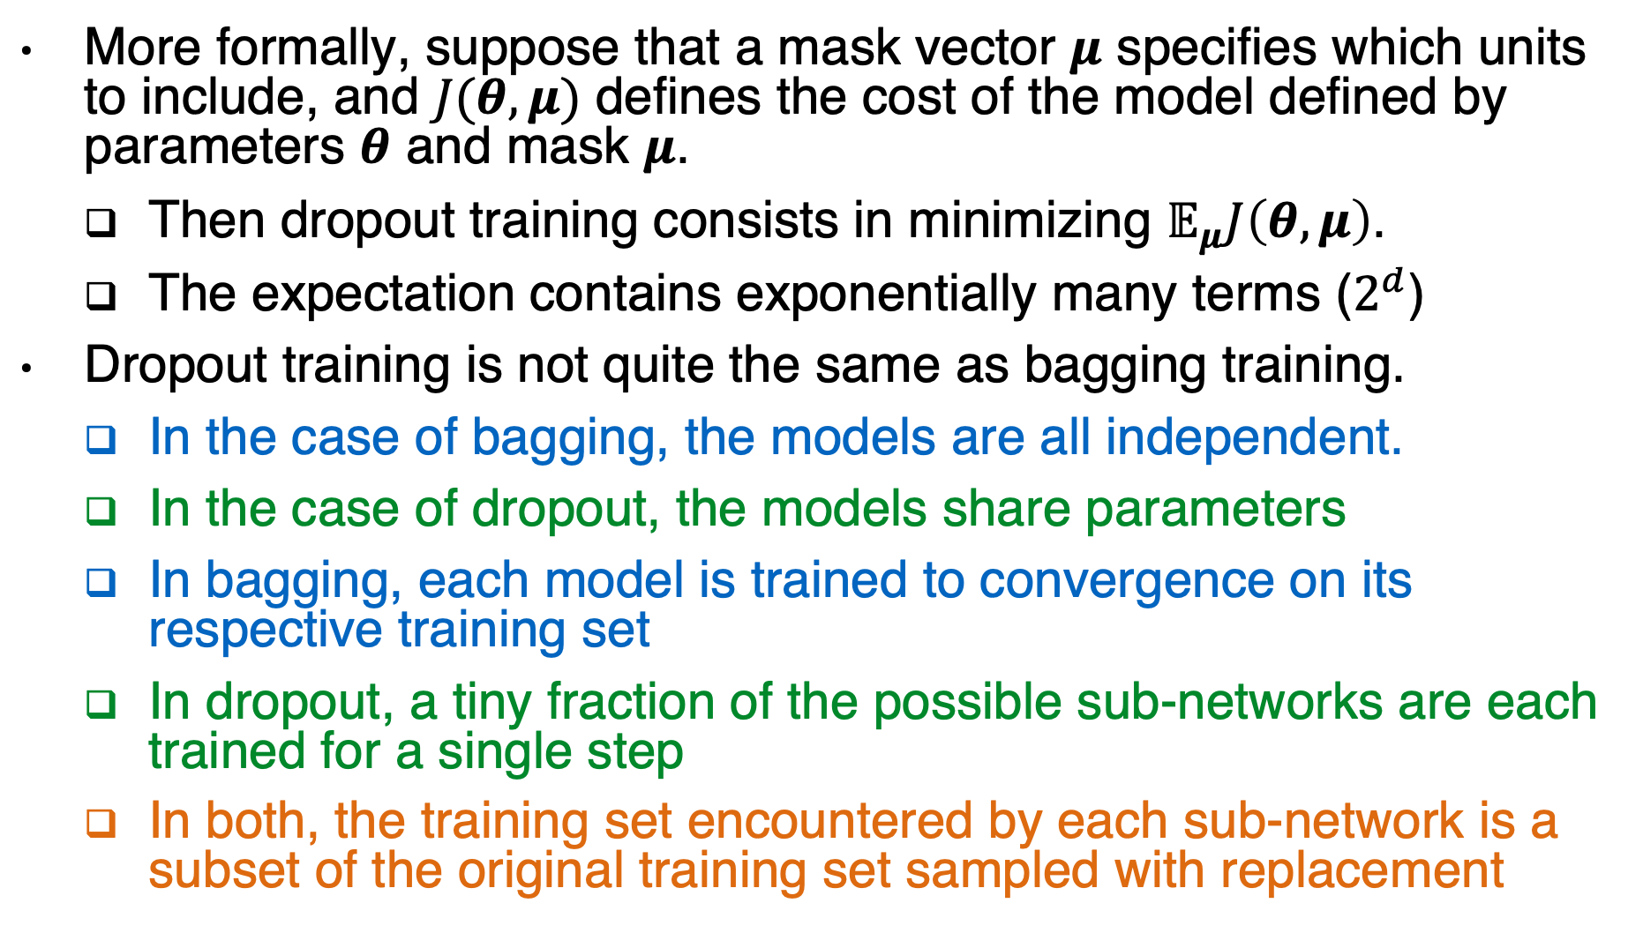
Dropout vs. bagging
More formally, suppose that a mask vector $μ$ specifies which units to include, and $J(θ,μ)$ defines the cost of the model defined by parameters $θ$ and mask $μ$.
Then dropout training consists in minimizing $𝔼_{μ}J\left(θ, μ\right)$.
The expectation contains exponentially many terms ($2^{d}$)
Dropout training is not quite the same as bagging training.
In the case of bagging, the models are all independent.
In the case of dropout, the models share parameters
In bagging, each model is trained to convergence on its respective training set
In dropout, a tiny fraction of the possible sub-networks are each trained for a single step
In both, the training set encountered by each sub-network is a subset of the original training set sampled with replacement

Slide 44
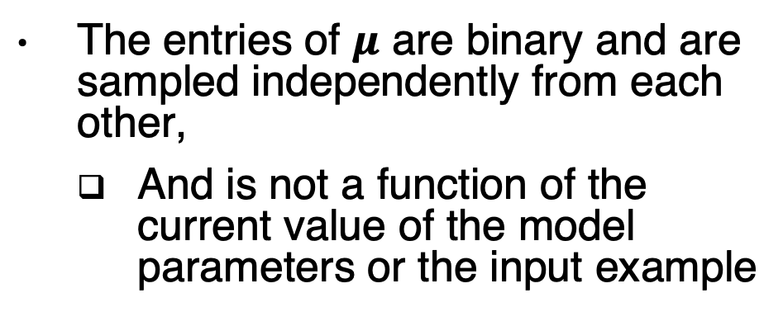
Computational graph of dropout
The entries of $μ$ are binary and are sampled independently from each other,
And is not a function of the current value of the model parameters or the input example

Slide 45
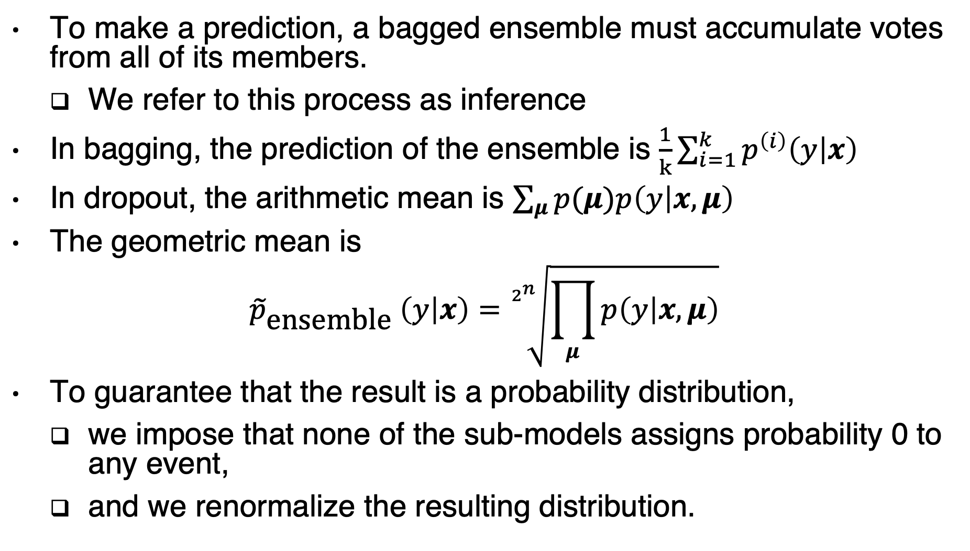
Inference
To make a prediction, a bagged ensemble must accumulate votes from all of its members.
We refer to this process as inference
In bagging, the prediction of the ensemble is $\frac{1}{k}\sum_{i=1}^{k}{p^{\left(i\right)}\left(y | x\right)}$
In dropout, the arithmetic mean is $\sum_{μ}{p(μ)p\left(y | x,μ\right)}$
The geometric mean is
$${\tilde{p}}_{\text{ensemble}} \left(y | x\right)=\sqrt[2^{n}]{\prod_{μ}{p\left(y | x,μ\right)}}$$
To guarantee that the result is a probability distribution,
we impose that none of the sub-models assigns probability 0 to any event,
and we renormalize the resulting distribution.

Slide 46
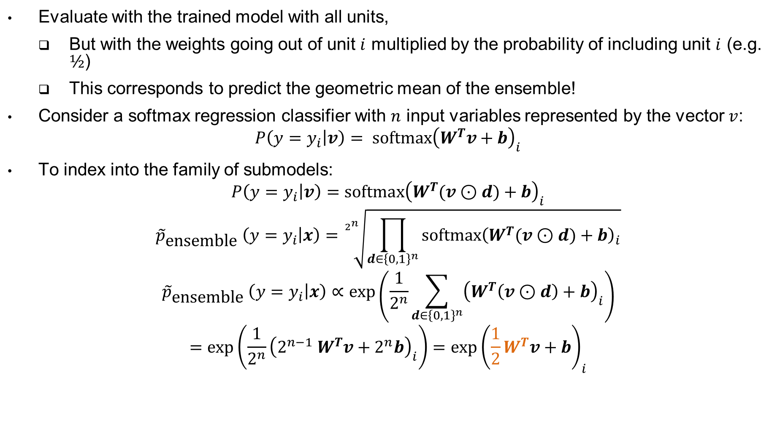
Weight scaling inference rule
Evaluate with the trained model with all units,
But with the weights going out of unit $i$ multiplied by the probability of including unit $i$ (e.g. $½$)
This corresponds to predict the geometric mean of the ensemble!
Consider a softmax regression classifier with $n$ input variables represented by the vector $v$:
$$P\left(y=y_{i} | v\right)= \text{softmax}{\left(W^{T}v+b\right)}_{i}$$
To index into the family of submodels:
$$P\left(y=y_{i} | v\right)=\text{softmax}{\left(W^{T}(v⊙d)+b\right)}_{i}$$
$${\tilde{p}}_{\text{ensemble}} \left(y=y_{i} | x\right)=\sqrt[2^{n}]{\prod_{d∈{\left\{0,1\right\}}^{n}}{\text{softmax}{\left(W^{T}(v⊙d)+b\right)}_{i}}}$$
$${\tilde{p}}_{\text{ensemble}} \left(y=y_{i} | x\right)∝\exp\left(\frac{1}{2^{n}}\sum_{d∈{\left\{0,1\right\}}^{n}}{{\left(W^{T}\left(v⊙d\right)+b\right)}_{i}}\right)$$
$$=\exp\left(\frac{1}{2^{n}}{\left(2^{n−1} W^{T}v+2^{n}b\right)}_{i}\right)={\exp\left(\frac{1}{2}W^{T}v+b\right)}_{i}$$
Notes:
The weight scaling rule is also exact in other settings, including regression
networks with conditionally normal outputs, and deep networks that have hidden
layers without nonlinearities. However, the weight scaling rule is only an approximation
for deep models that have nonlinearities. Though the approximation has
not been theoretically characterized, it often works well, empirically.
Pytorch: The outputs are scaled by a factor of \frac{1}{1-p} during training.
This means that during evaluation the module simply computes an identity function.

Slide 47
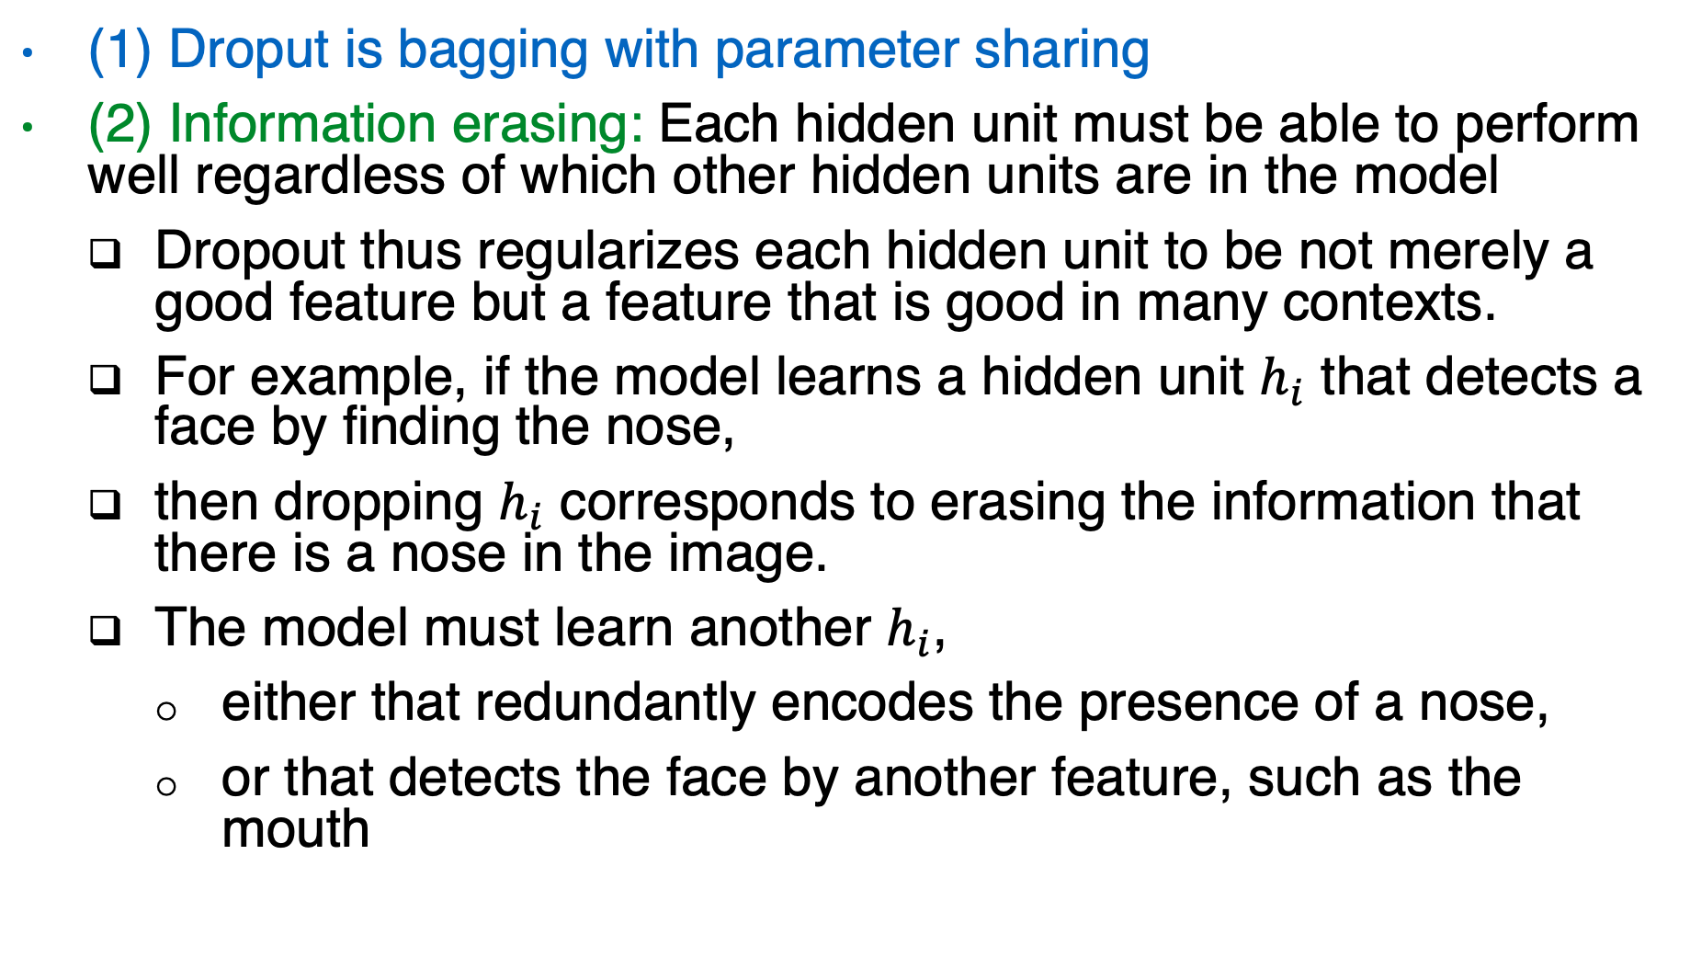
Another perspective of dropout
(1) Droput is bagging with parameter sharing
(2) Information erasing: Each hidden unit must be able to perform well regardless of which other hidden units are in the model
Dropout thus regularizes each hidden unit to be not merely a good feature but a feature that is good in many contexts.
For example, if the model learns a hidden unit $h_{i}$ that detects a face by finding the nose,
then dropping $h_{i}$ corresponds to erasing the information that there is a nose in the image.
The model must learn another $h_{i}$,
either that redundantly encodes the presence of a nose,
or that detects the face by another feature, such as the mouth

Slide 48
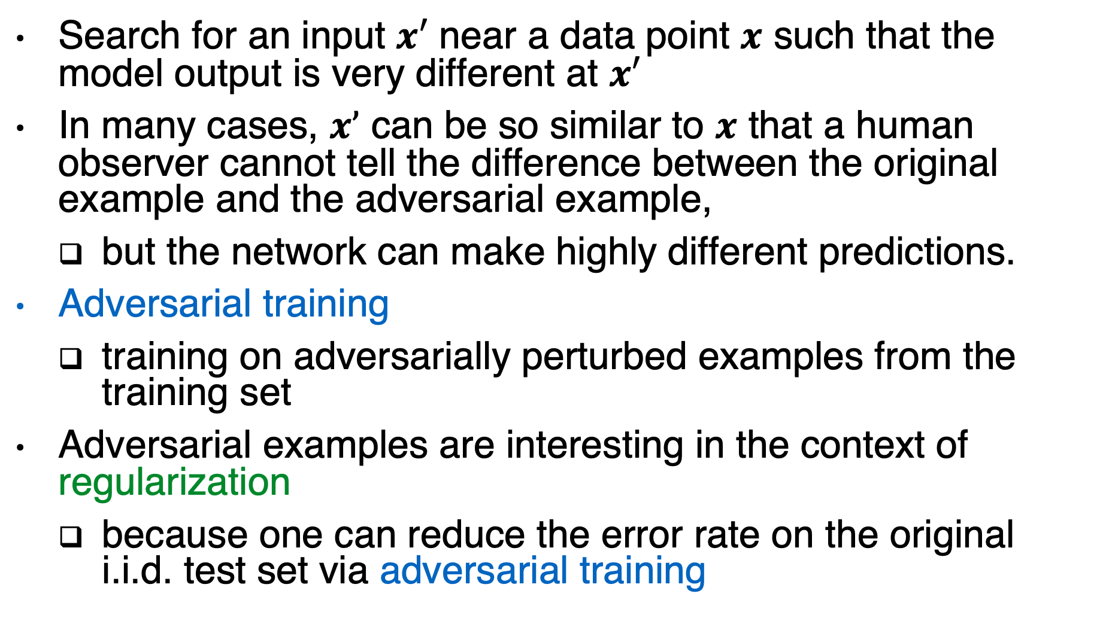
Adversarial examples
Search for an input $x′$ near a data point $x$ such that the model output is very different at $x′$
In many cases, $x’$ can be so similar to $x$ that a human observer cannot tell the difference between the original example and the adversarial example,
but the network can make highly different predictions.
Adversarial training
training on adversarially perturbed examples from the training set
Adversarial examples are interesting in the context of regularization
because one can reduce the error rate on the original i.i.d. test set via adversarial training

Slide 49
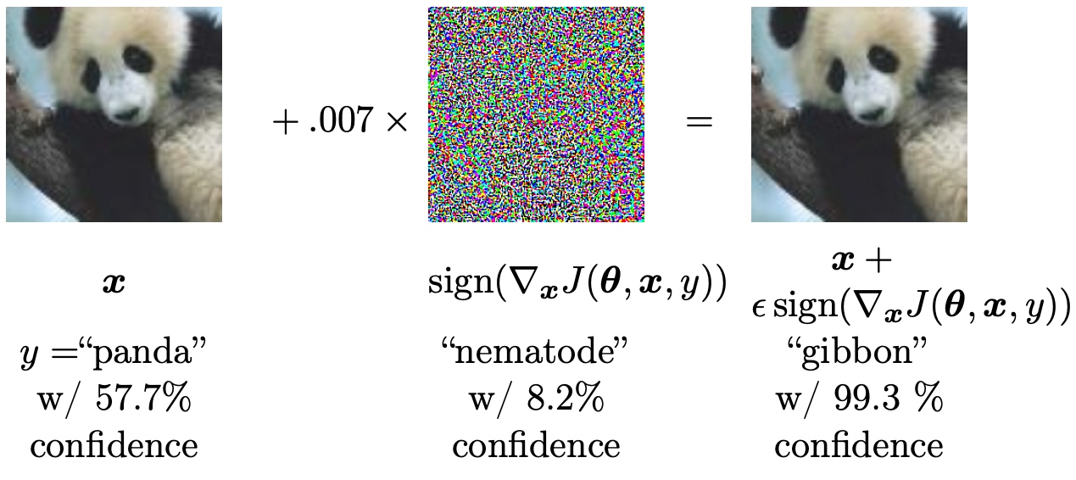
Adversarial Examples
Figure 7.8
Training on adversarial examples is mostly intended to improve security, but can sometimes provide generic regularization.
Notes:
Nematode: a kind of worms
Gibbon : a kind of apes

Slide 50
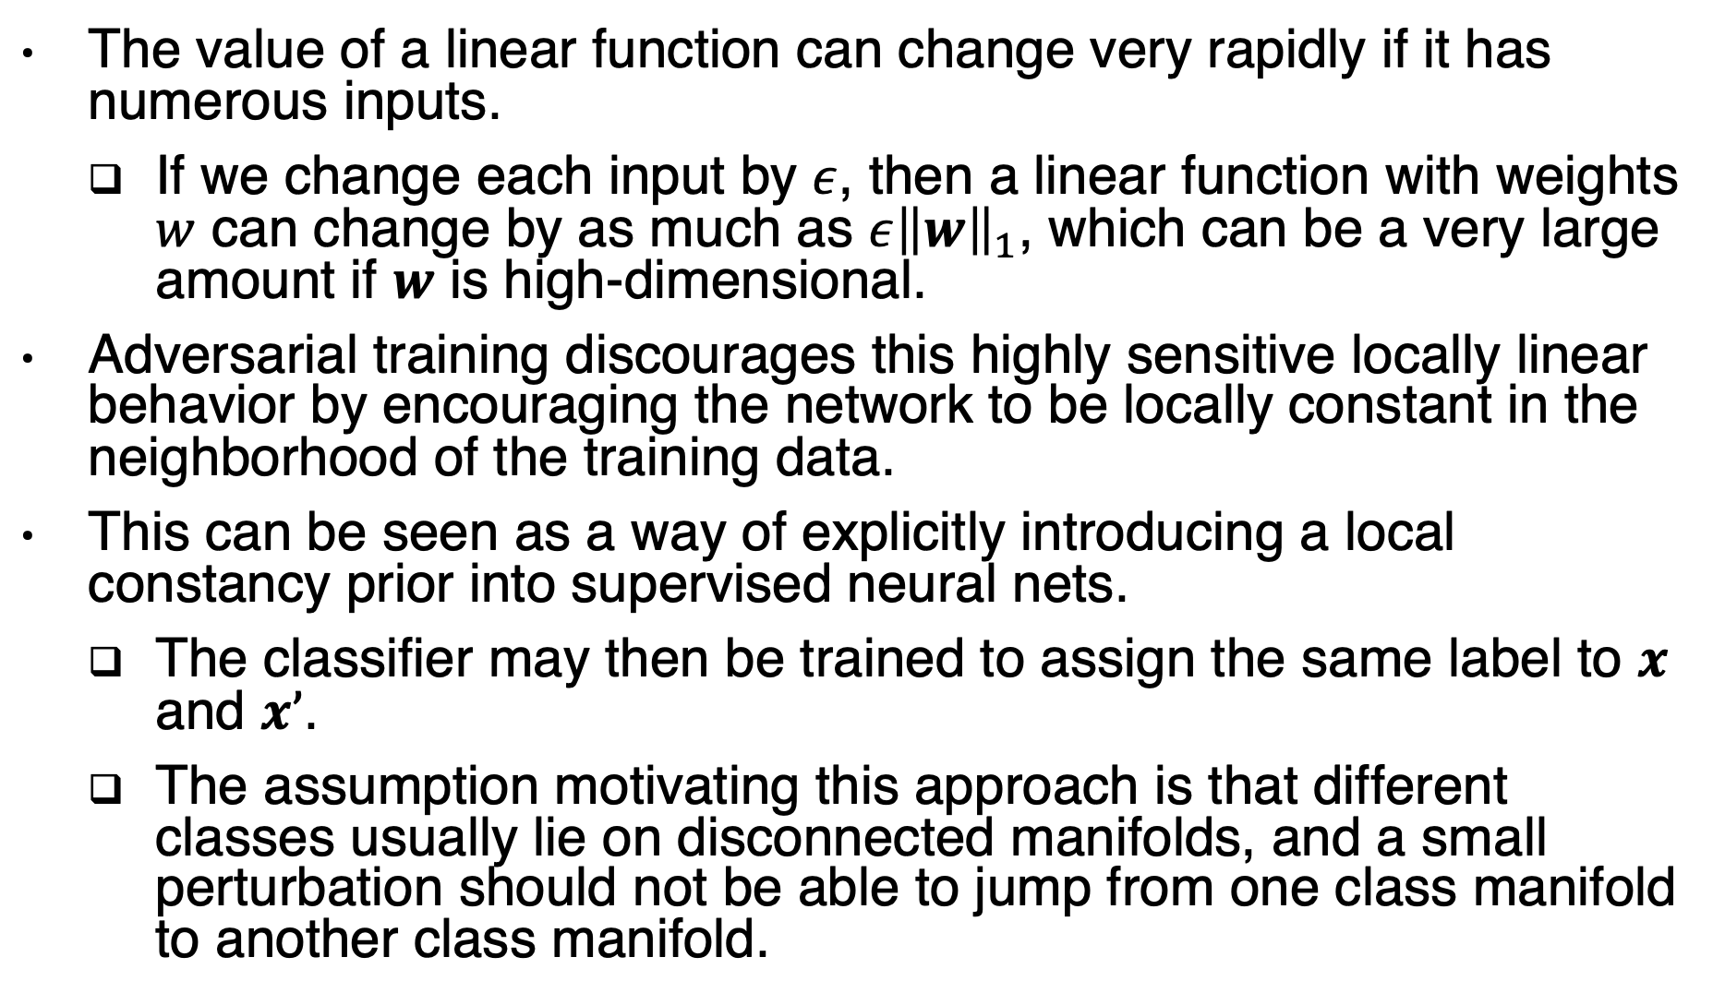
Aversarial training
The value of a linear function can change very rapidly if it has numerous inputs.
If we change each input by $ε$, then a linear function with weights $w$ can change by as much as ${ε\left\|w\right\|}_{1}$, which can be a very large amount if $w$ is high-dimensional.
Adversarial training discourages this highly sensitive locally linear behavior by encouraging the network to be locally constant in the neighborhood of the training data.
This can be seen as a way of explicitly introducing a local constancy prior into supervised neural nets.
The classifier may then be trained to assign the same label to $x$ and $x’$.
The assumption motivating this approach is that different classes usually lie on disconnected manifolds, and a small perturbation should not be able to jump from one class manifold to another class manifold.

Slide 51
Conclusion
This chapter has described most of the general strategies used to regularize neural networks.
Regularization is a central theme of machine learning
Our next topic is: optimization

Slide 52
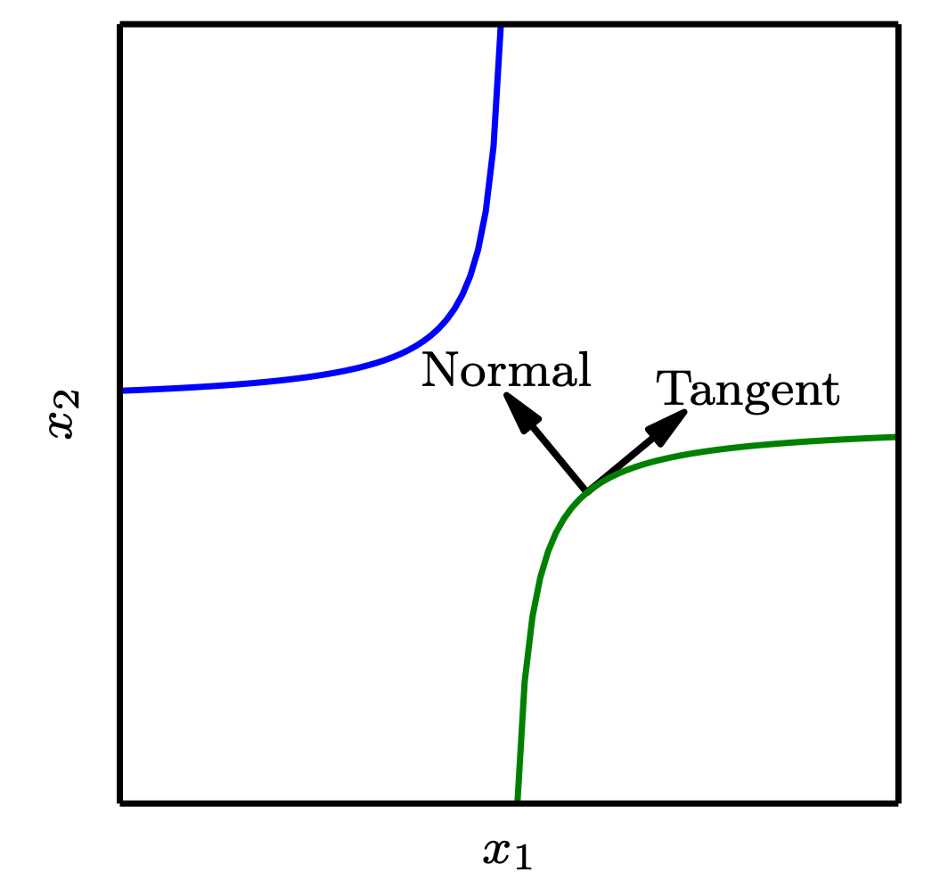
Tangent Propagation
Figure 7.9

